Slide 1

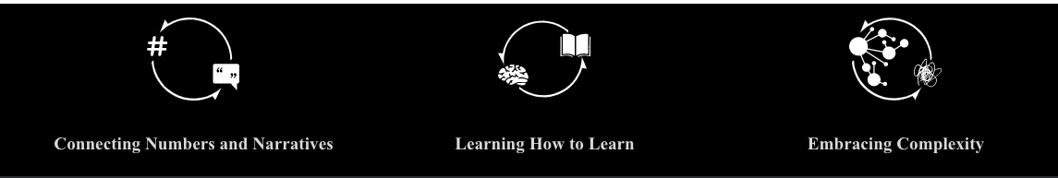
PFI 3: International trade, conflict, and catastrophe in GCAM

Slide 2
GCAM Student Projects
International trade, conflict, and catastrophe

Slide 4
Overall comments
Shift focus a bit to pedagogy
Group 1 slide on what it is like to run GCAM was really clever
what is it like working in an interdisciplinary setting?
Less words on slides
simpler figures
instead of focus on results, focus on what we learned
where did we fail and what challenges did we face?
How does our work relate to the three D3M tenets:
Numbers and narratives
learning how to learn
embracing complexity

Slide 5



Agenda
Takeaways,
Critiques,
Numbers and Narratives
Approaches
Student Projects

Slide 6
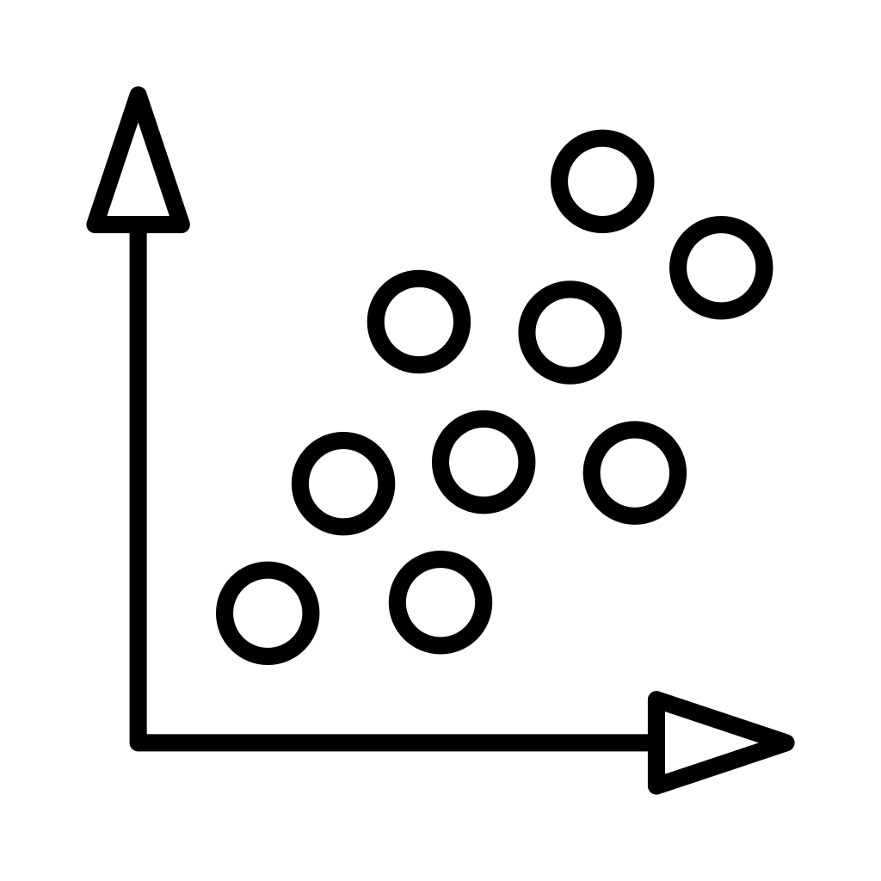


Two ways to approach GCAM….
Semester 2
Semester 1
Notes:
Semester 1: -trans science, -models for SSP + RCP, academic role, numbers and narratives, challenges of modelling complex systems

Slide 7
Two ways to approach GCAM….
Semester 2
Semester 1
Group 1: Typical GCAM Use
Explore unknown futures
Unanticipated policy effects
Challenges of running the model
Notes:
Semester 1: -trans science, -models for SSP + RCP, academic role, numbers and narratives, challenges of modelling complex systems

Slide 8
Two ways to approach GCAM….
Semester 2
Semester 1
Group 1: Typical GCAM Use
Group 2: Atypical GCAM Use
Explore unknown futures
Unanticipated policy effects
Challenges of running the model
Short term change within long-term model
Failure to capture key dynamics
Any conflict linkages?
Notes:
Semester 1: -trans science, -models for SSP + RCP, academic role, numbers and narratives, challenges of modelling complex systems

Slide 9
Evaluating Potential Impacts of Policy on Food and Water System Dynamics
Ian Moore, Tyrine Pangan, Isaac Thompson, Maggie Roberts

Slide 10
Pedagogy for Interdisciplinary Immersion Program (PFI-1)
Team-based Problem-solving
Project-based Course
Working with peers in an immersive data-focused experience that promotes rapid iterations, feedback, and revisions to enhance learning skills
Primary goal across two semesters is to explore initial ideas to research a problem and create a demonstrable prototype from the chosen problem
Notes:
Most academic preparation is siloed by courses and disciplines, but problems in the real world require collaboration among and input from professionals and practitioners with a broad range of preparation
An overarching theme of these program elements is to show how a chosen problem can be used to advance foundational ideas and theory in data science for improved decision making by focusing on several interrelated activities described below.
Pedagogy
team-based problem-solving experience with rapid iterations, feedback, and revision to apply and enhance students’ skills and learning in an intense, immersive data-focused experience.
This program is inspired and informed by effective educational experiences that bring diverse teams to address difficult challenges.
Project-based courses, where the primary goal is to research a problem and create a demonstrable prototype over the course of a semester, are a key educational innovation and provide transformative experiences for students
This allows the team to explore initial ideas via semester-long (Fall Colloquium) activity, then plan more specific activities over the next semester (Spring Colloquium) with a chosen problem. This immersion program leverages logistical support from Tufts DISC initiative

Slide 11
Exploring how Climate Change Policy Implementation Affects Global Food and Water Systems
Part 1
What shifting dynamics do we see across global water and agriculture sectors when climate change policy is implemented?
Part 2
Can implementing preferences for international vs. domestic alleviate water and food stress introduced by climate change policy implementation?
Notes:
Earlier last semester, our PFI spent some time exploring GCAM and trying to figure out what questions we can ask within the capabilities of GCAM
At first, everyone in the class was tasked with learning the basics of GCAM to explore databases and come up with plots with reference files as a way to think about different topics we might be interested in
Then, after messing around with GCAM for a bit, our next focus was to start defining research questions and propose experimental designs.
Once we all individually came up with our own initial research questions, we got feedback in class and based on the similarities of research interests, our PFI ended up with 2 groups.
Read questions

Slide 12



Reality of Implementing Different GCAM Scenarios
Learning to Navigate
Troubleshooting
Seeking Expertise
Received helpful instructions and tips from Delilah Maloney to navigate the Tufts HPC Cluster
Even with proper instructions, ran into issues setting up GCAM and learning how to troubleshoot
Reached out to other students from Jon’s lab (Abigail and Jake) to get useful .xml files for policies
Notes:
Once we determined our research questions, we had to learn how to get GCAM up and running.
At first, we were introduced by Delilah Maloney on how to navigate the Tufts HPC cluster
Although she provided a lot of helpful information and instructions, we ran into issues on setting up GCAM such as getting GCAM to compile and use certain libraries
In several instances, everyone in the PFI worked together to troubleshoot these problems through meetings outside class and talking through some of the problems in class
Once our group was able to get GCAM to work, we then reached out to students from Jon’s lab (Abigail and Jake) to get useful .xml files to look at the impact of different policies to answer our research question
Overall, this experience trying to get GCAM working was a bit frustrating at times but the experience was worth it because in the real world trying to solve real-world problems, not every tool we need to use will automatically work the way we want it to. Rather, we learned a lot about troubleshooting and being open to rely on others who have experience using GCAM
The main takeaway from this experience is that tools and data are not wrapped up in a neat little bow, especially GCAM that has been around I believe the 1980s

Slide 13

Methodology using GCAM
Running Four GCAM Scenarios
Reference
Historic preferences for trade
No climate change mitigation implemented
Climate Change Mitigation Scenario
High
High preference for international trade
Medium
Historic preference for international trade
Paris Agreement CO₂ equiv. emissions regulations
Low
Low preference for international trade
Evaluating Changes
1
Water withdrawals by basin
2
Staple food prices by region
Notes:
Methodology using GCAM
To answer our research question, our group ran four GCAM scenarios
The first was the reference scenario where no climate change mitigation was implemented.
We then explore how different levels of preference for international trade affected change in water withdrawals by basin and change in food staple prices by region

Slide 14
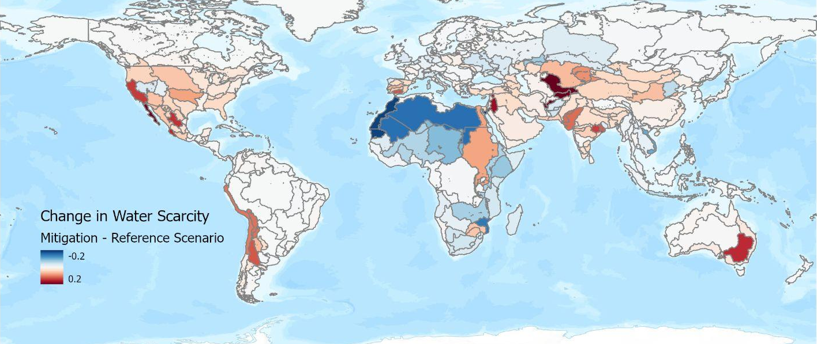
Changing Dynamics in Water Withdrawal:
Change in total physical water scarcity in 2100 between Climate Change Mitigation and Reference Scenario
Physical Water Scarcity - Ratio of water withdrawals to renewable water supply

Slide 15
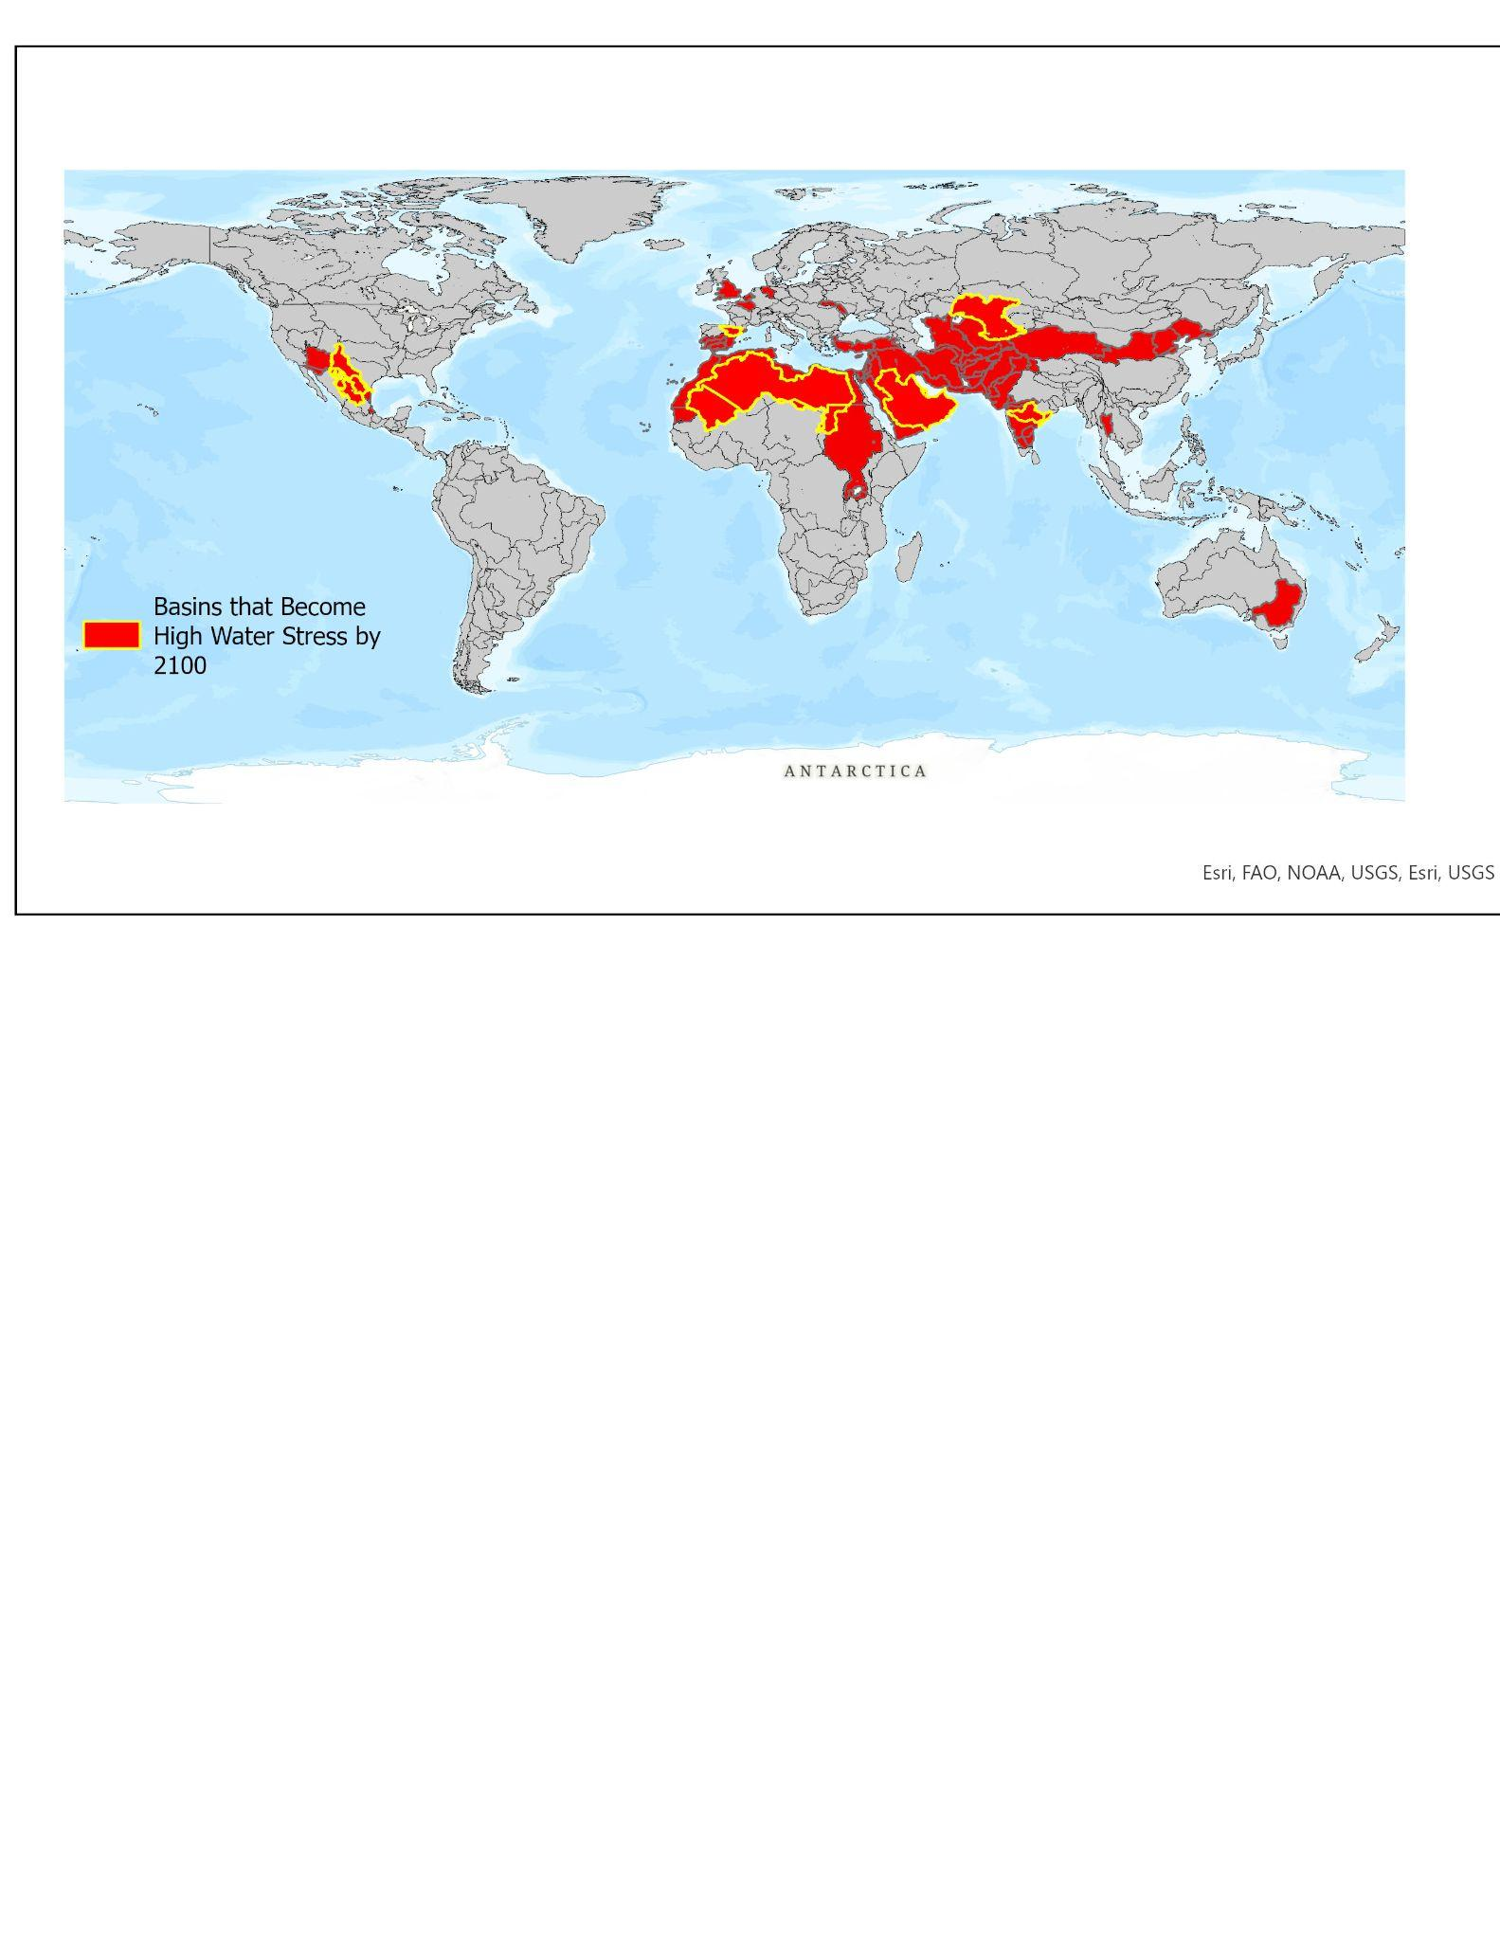
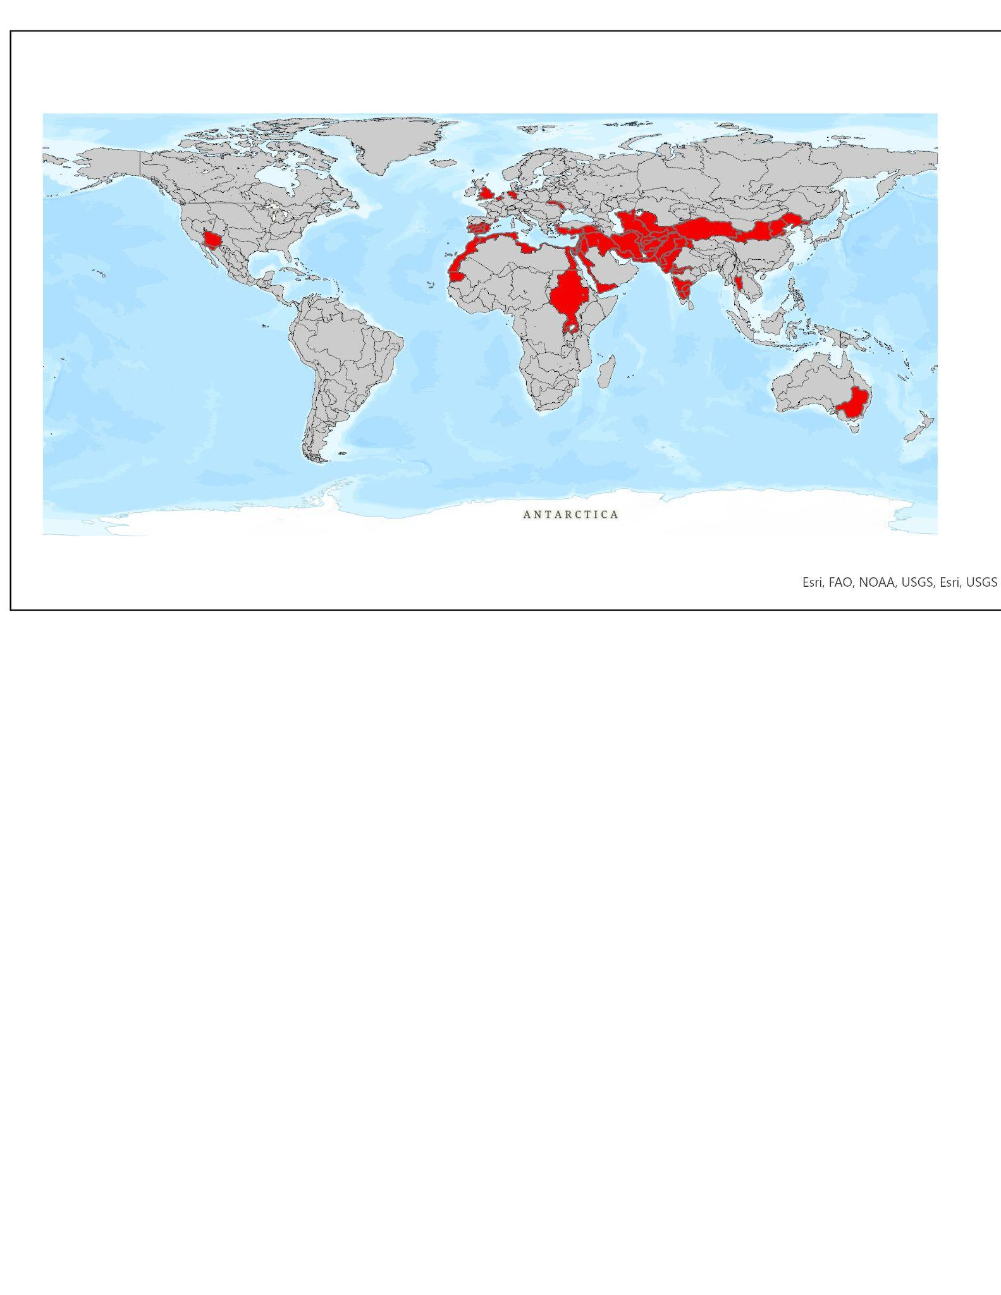
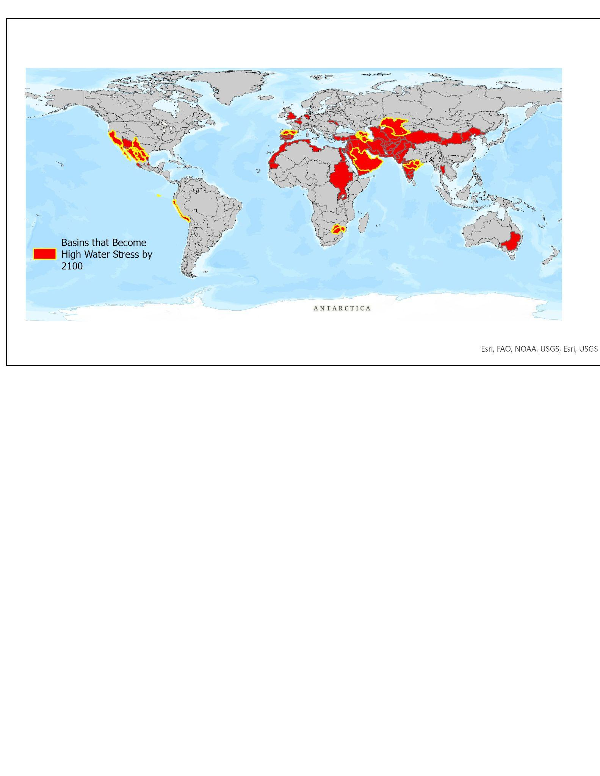
High Water Stress Basins
(Physical Water Scarcity > 0.4)
Reference:
High Water Stress Basins in 2100
High Water Stress Basins 2020
Climate Change Mitigation:
High Water Stress Basins in 2100

Slide 16
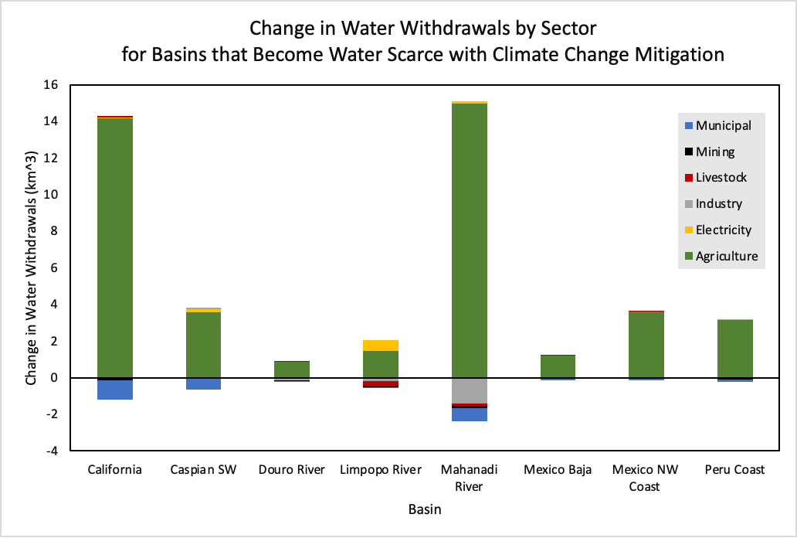
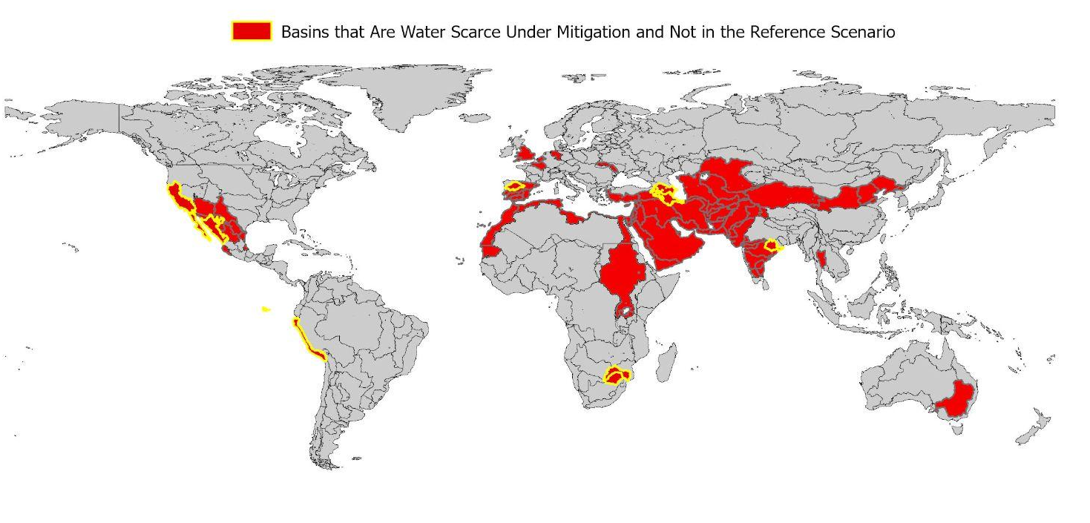
Change in Water Withdrawals in Basins that Become High Water Stress in the Mitigation Scenario
Agriculture drives water withdrawal changes in basins that become high water stress in 2100 when climate change mitigation is implemented

Slide 17
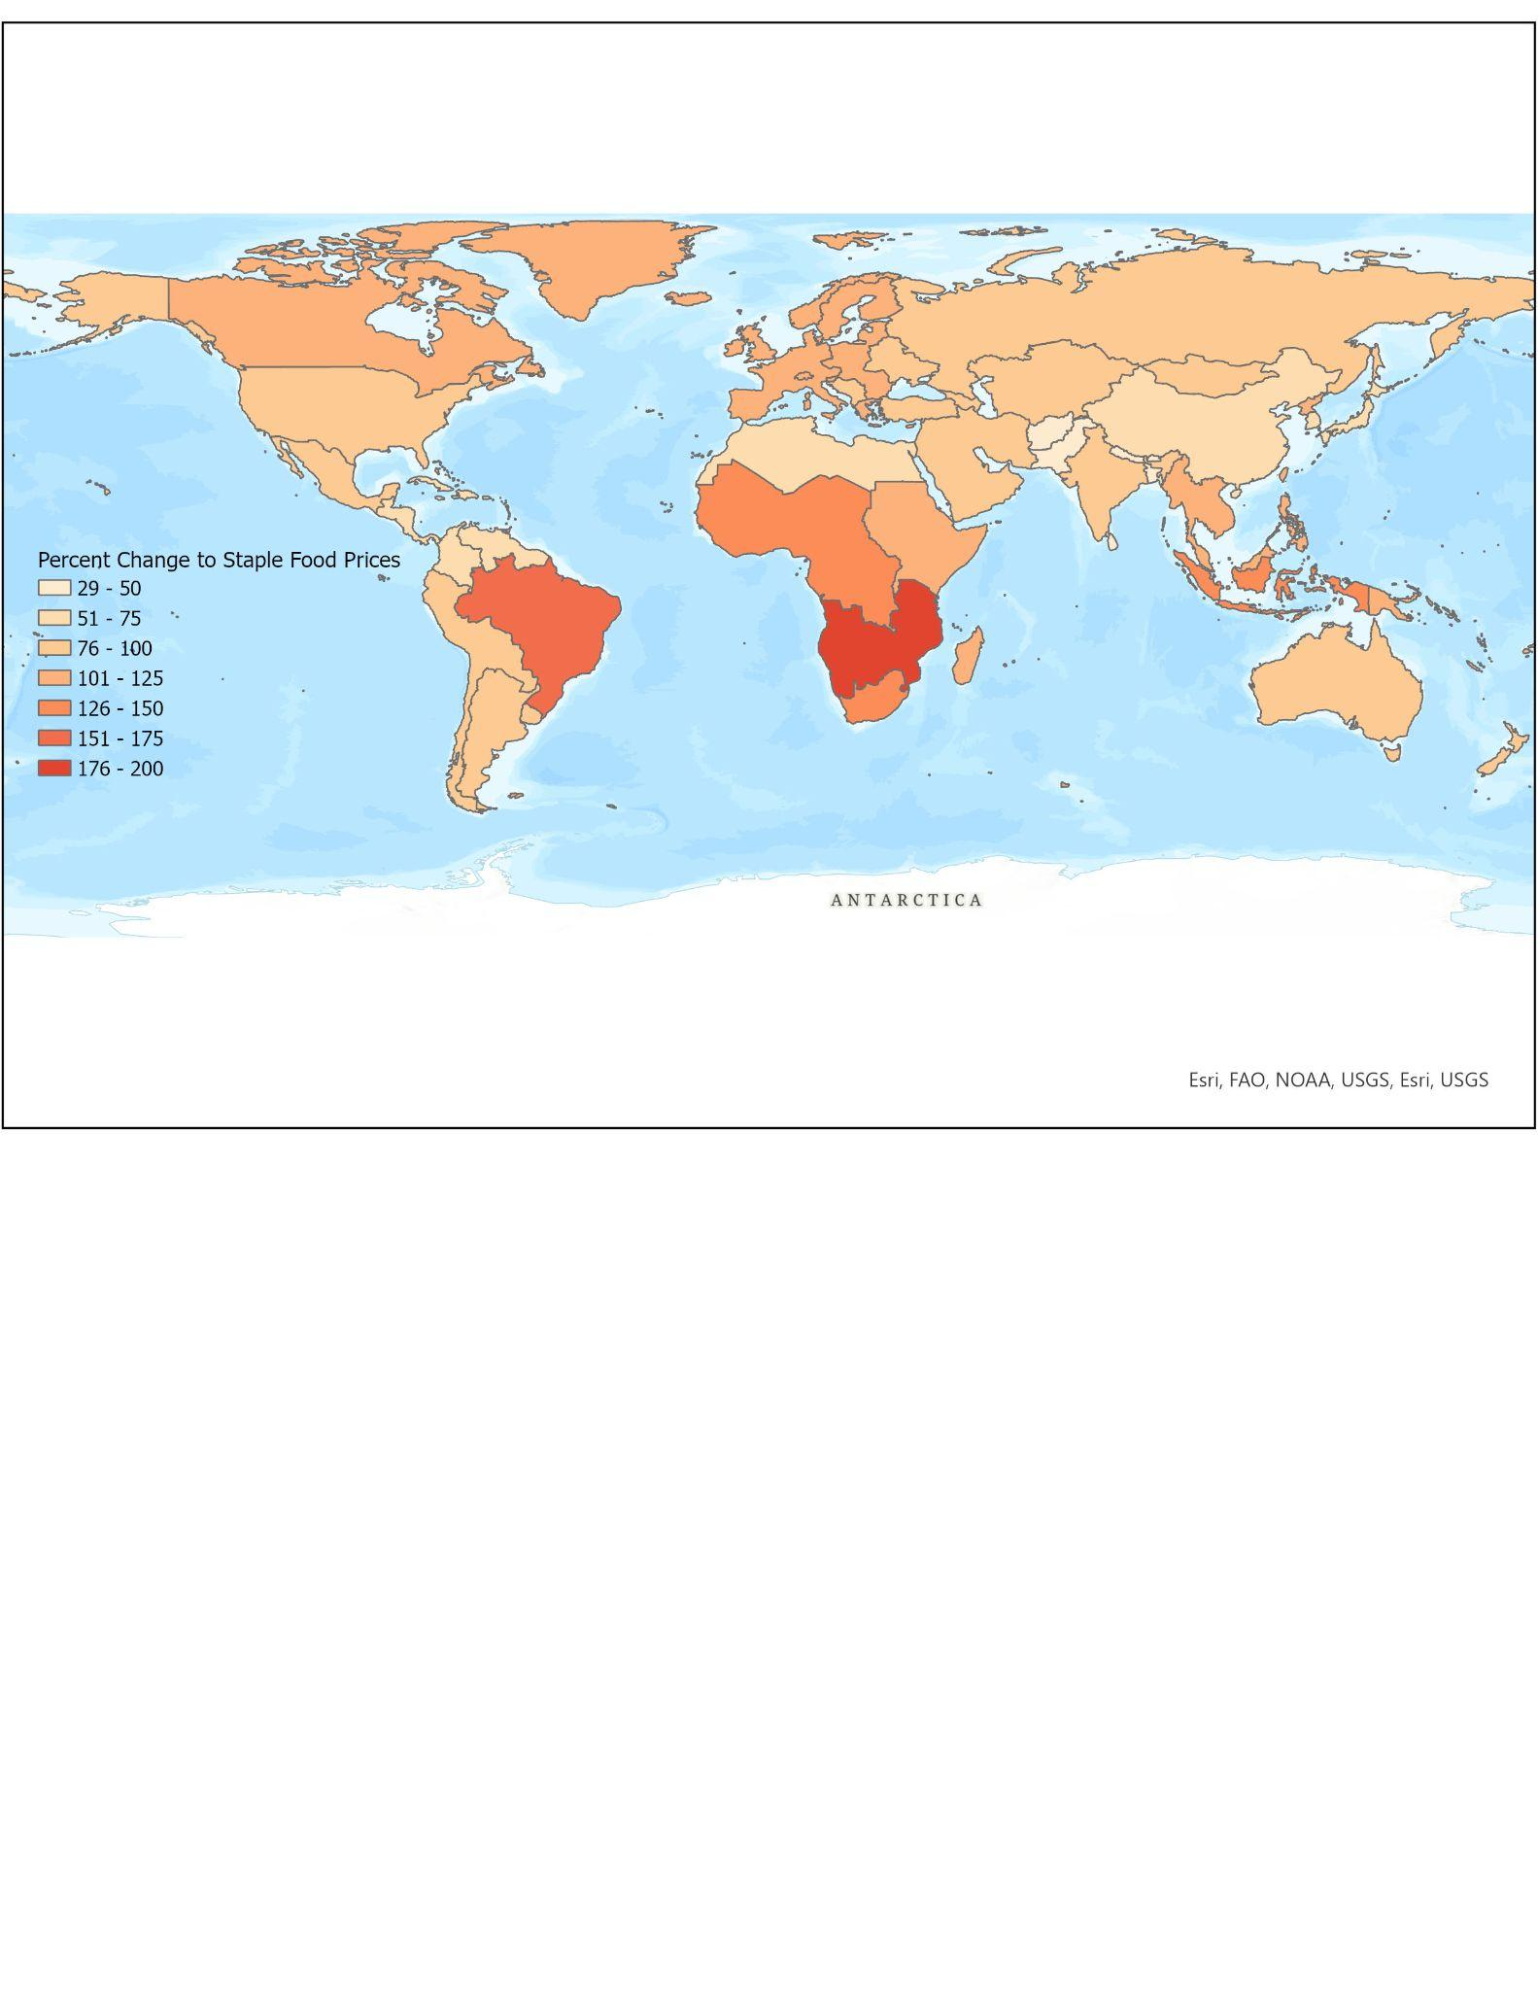
Changing Dynamics in Staple Food Prices:
Change in Average 2100 Staple Food prices between Climate Change Mitigation and Reference Scenario

Slide 18
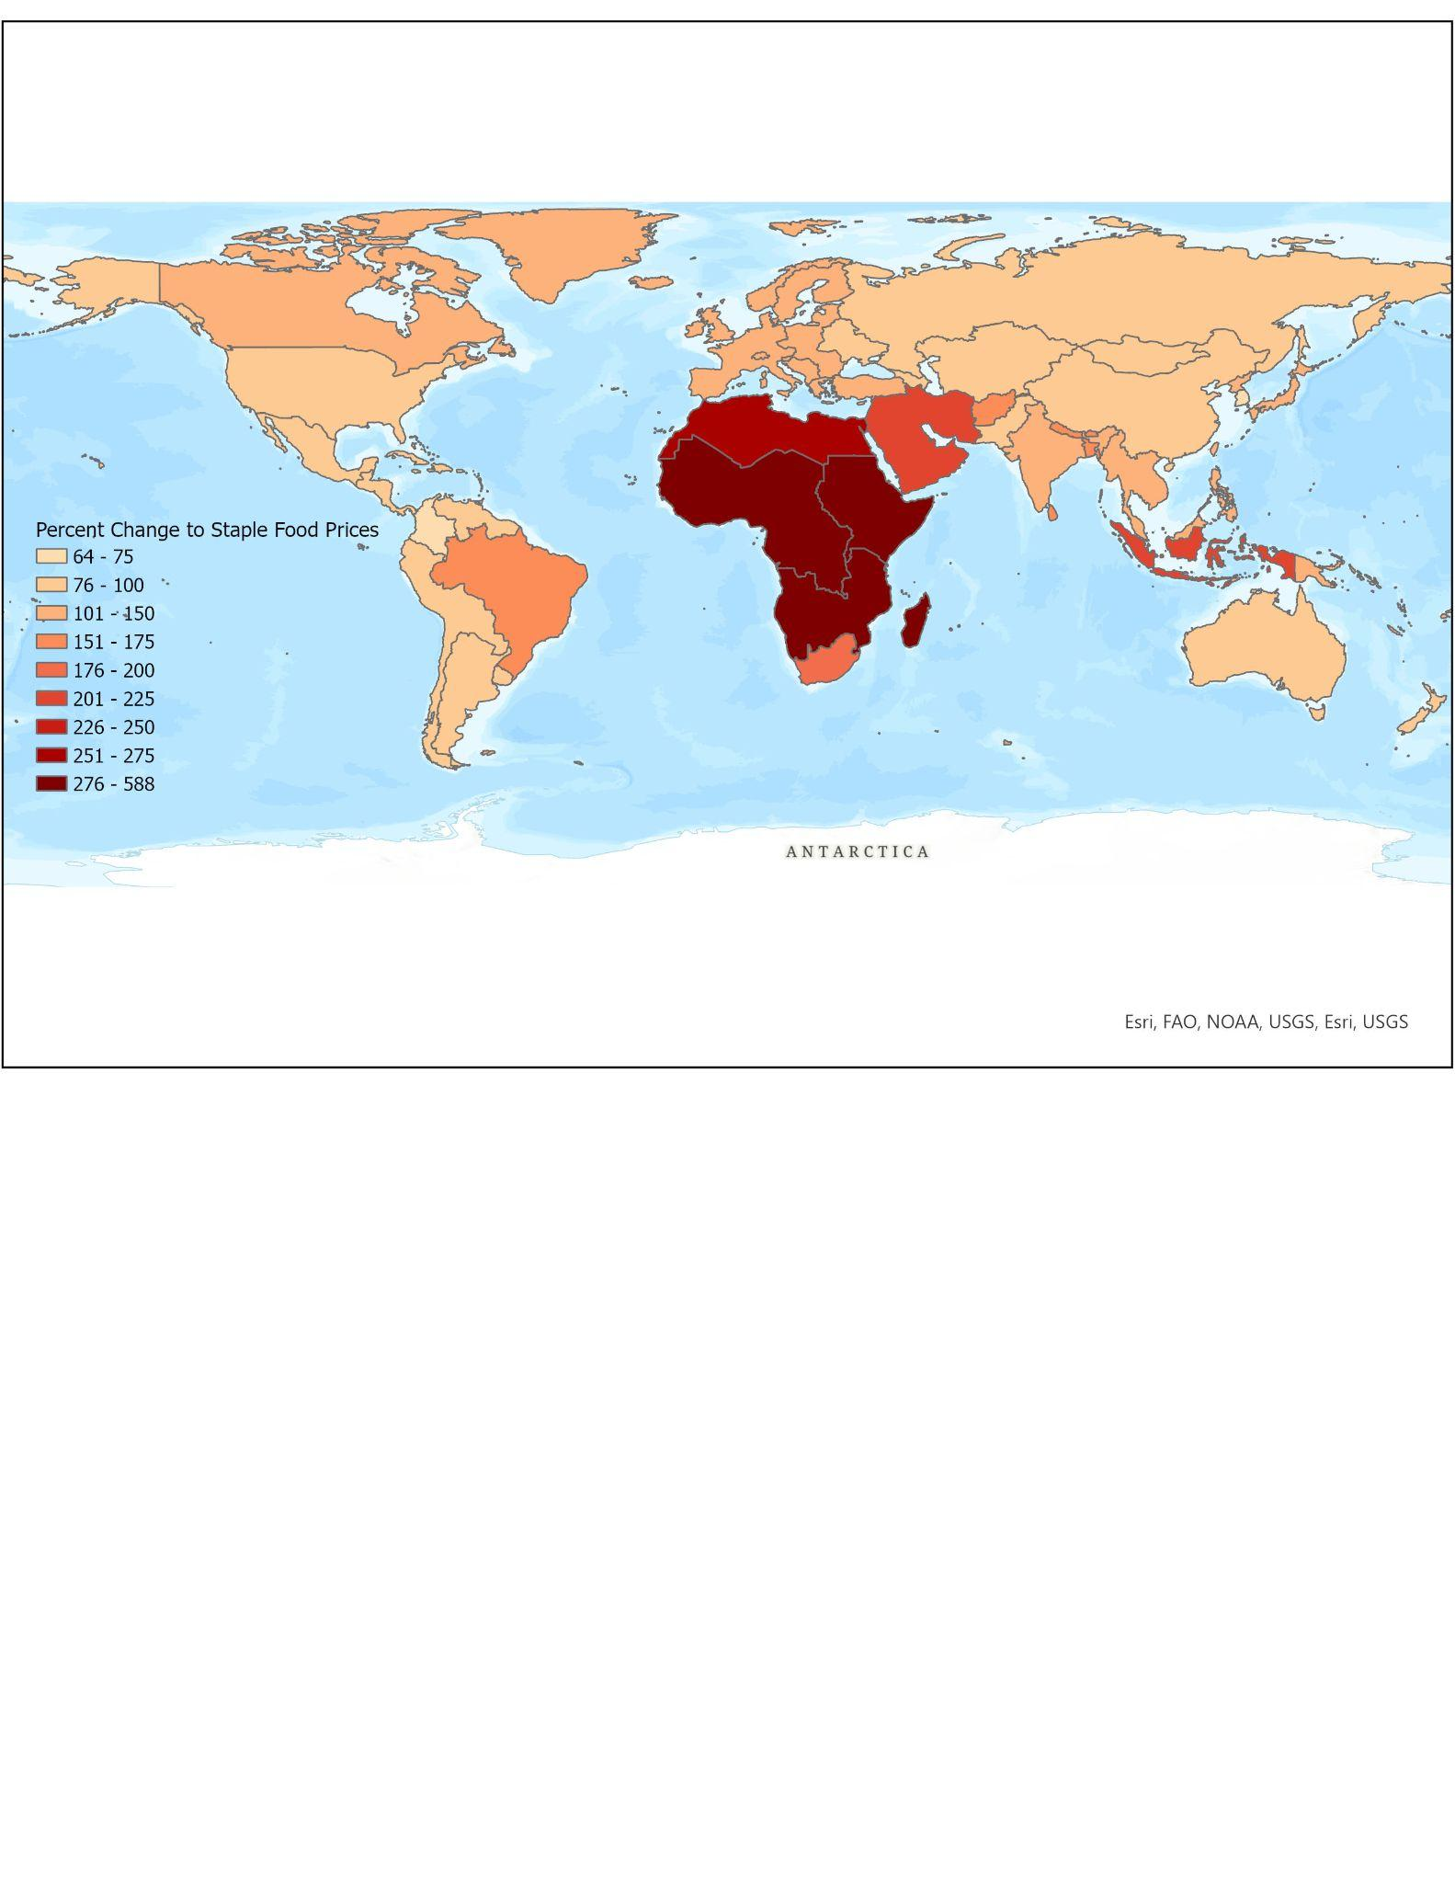
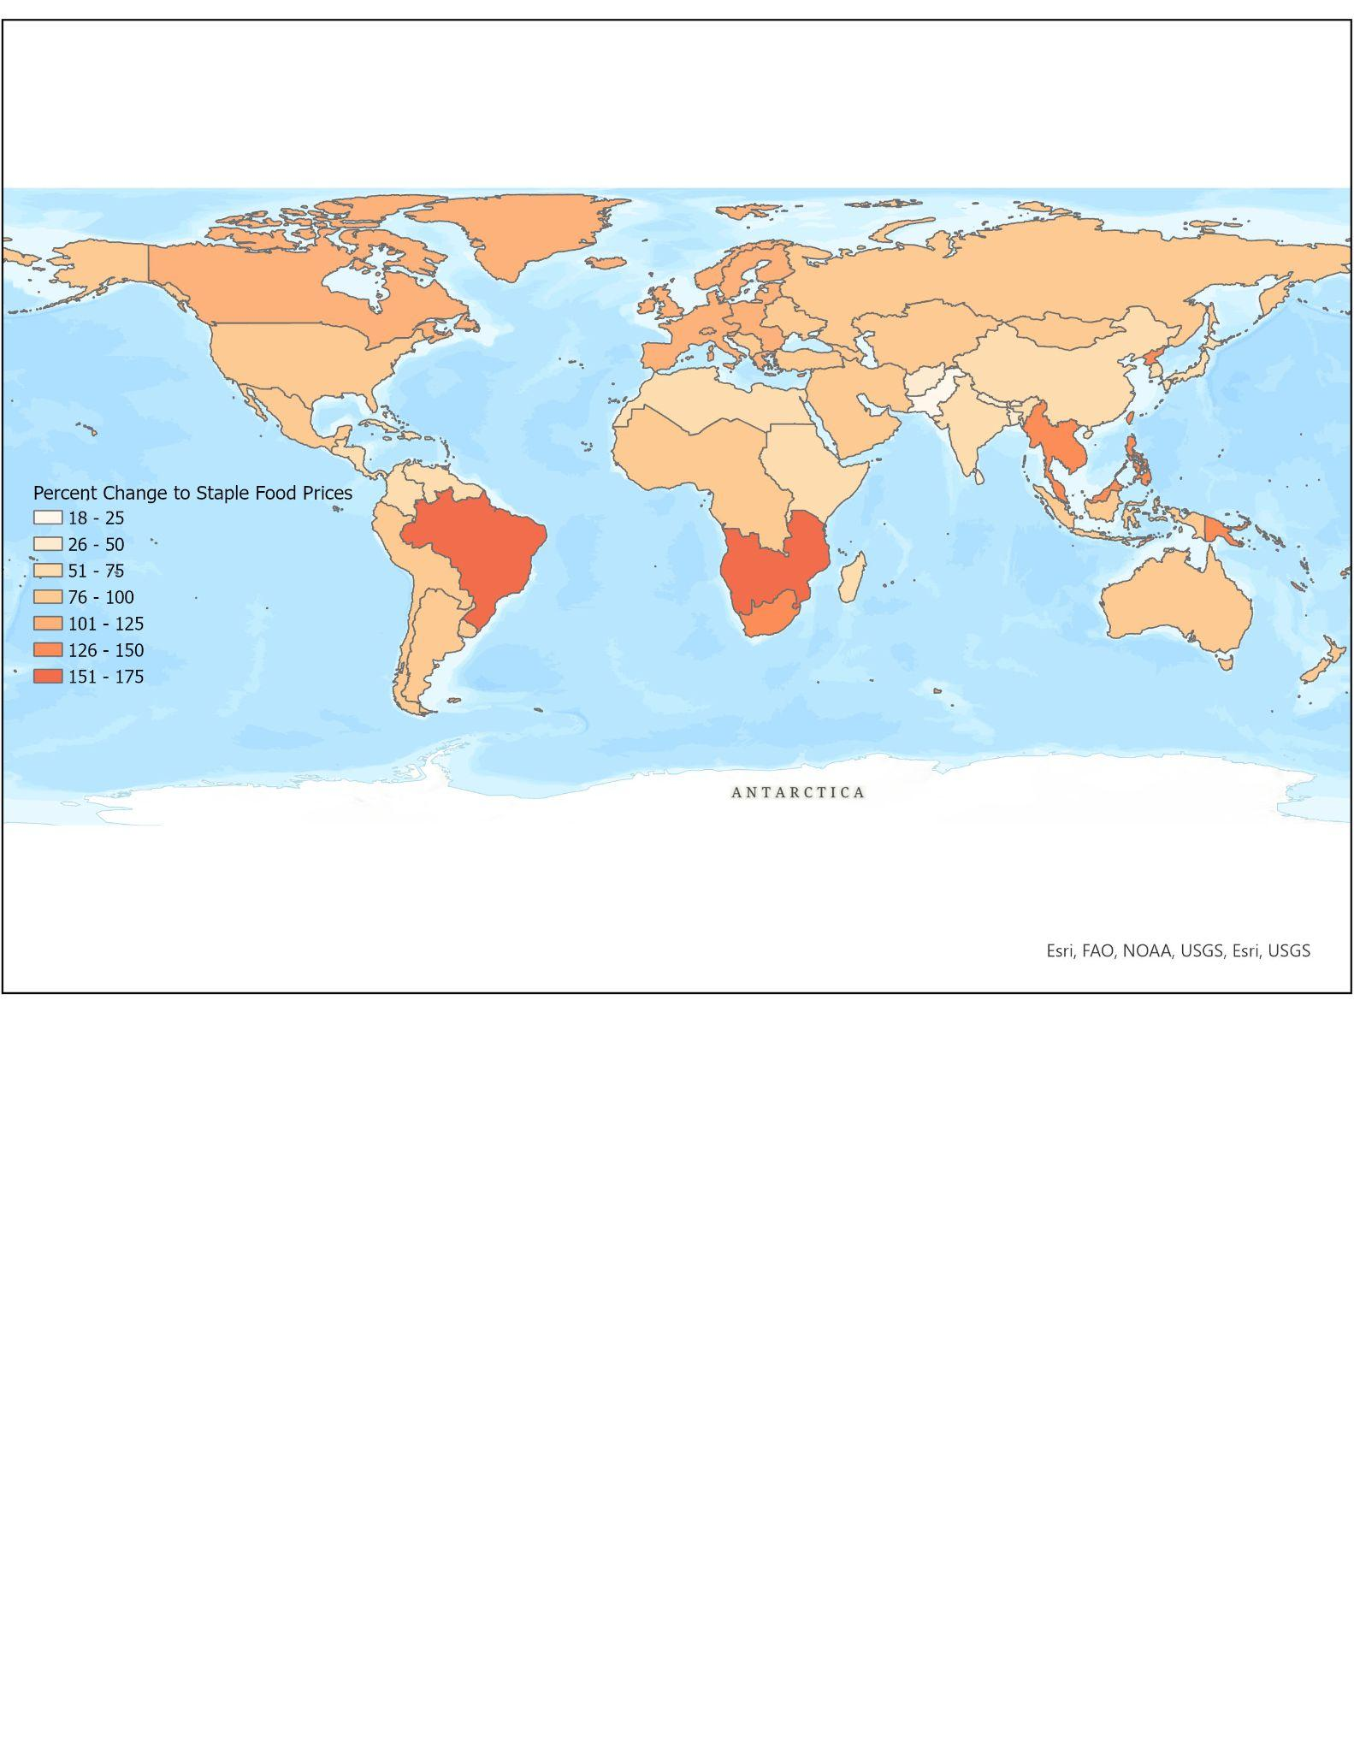
Shifting Trade Preferences Influences Climate Change Mitigation Impacts
Change to Staple Food Prices with Mitigation and Low Preference for International Trade
Staple food prices increase under climate change mitigation
Most significant change is seen in Africa and the Middle East
Shifting towards a higher preference for international trade could alleviate some of the increase
Change to Staple Food Prices with Mitigation and High Preference for International Trade

Slide 19
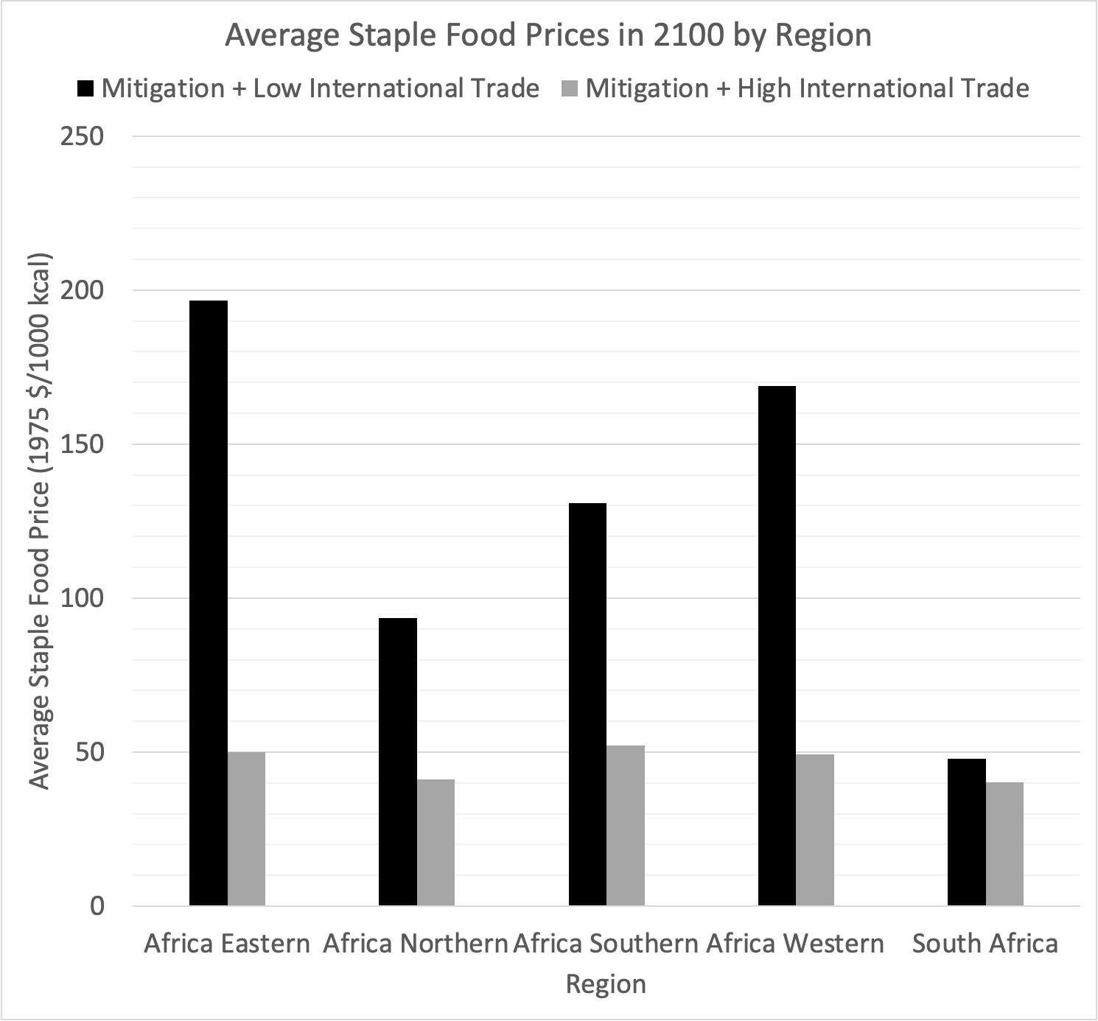
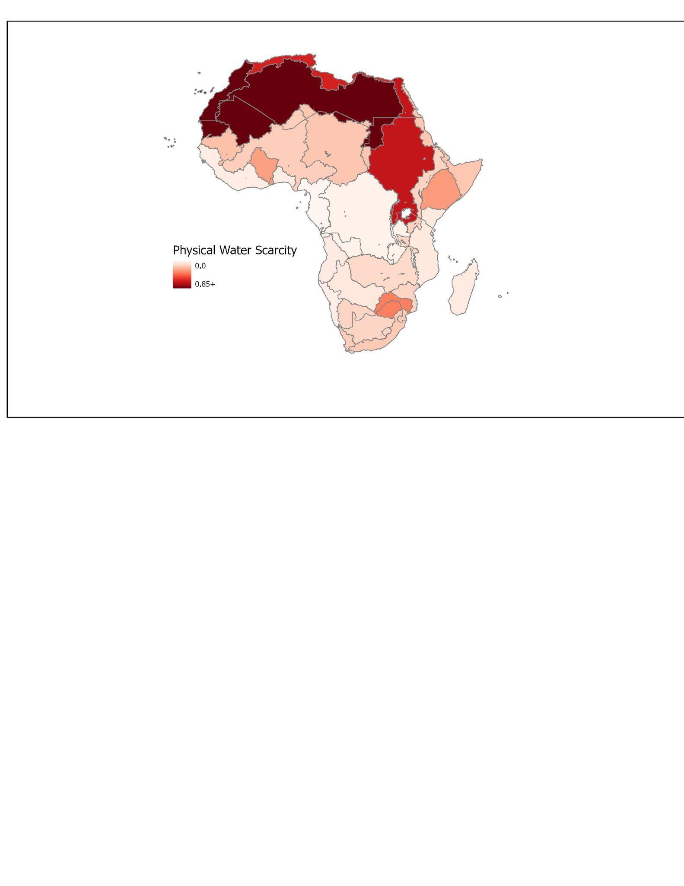
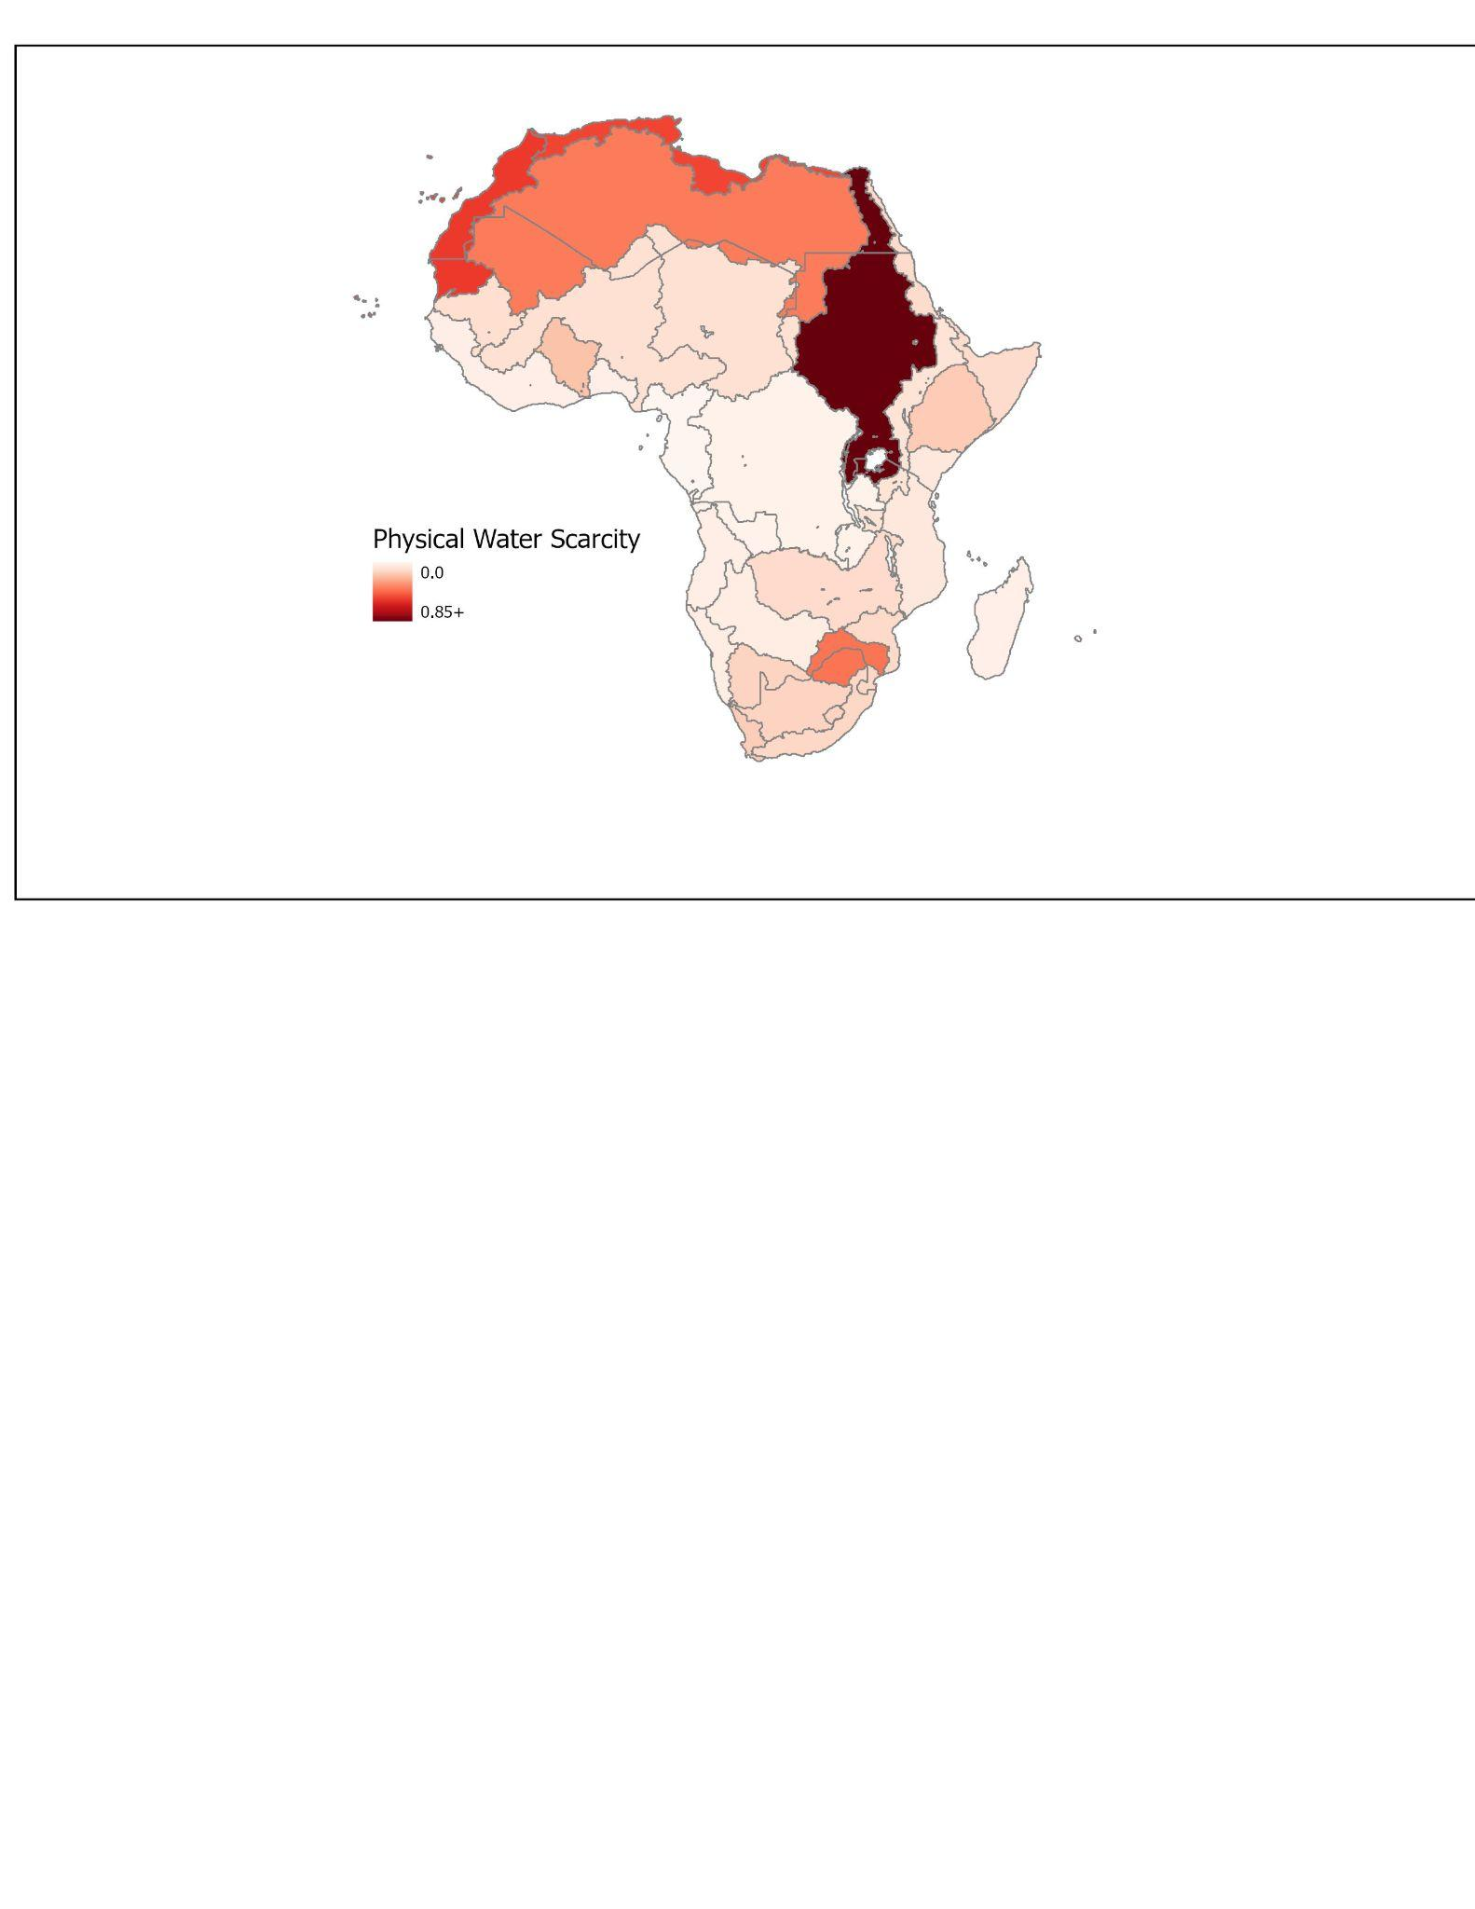
Impact of International Trade Preference and Climate Change Mitigation on Water Stress and Staple Food Prices in 2100
Staple Food Prices:
Physical Water Scarcity:
Mitigation + Low trade
Physical Water Scarcity:
Mitigation + High trade

Slide 20
Conclusions
GCAM helps us explore the interactions between food and water systems at a global scale
Evaluate a suite of “what-if” scenarios to determine what drives positive and negative changes to metrics of interest
Identify potential side-effects of mitigation policies

Slide 21
Reflections
Investigated ways GCAM can be integrated with narratives around climate change policy relating to water and food stress
Importance of learning how to fail and keep moving forward with our available resources
Climate change policy is complex and there are limits of what GCAM can do
Notes:
Numbers and Narratives
Developing narratives, while remaining true to the data, is a defining challenge of our time. Narratives are persuasive but not objective; numbers are often objective but not persuasive.
Learning how to Learn
As we mentioned earlier in this presentation, our group ran into some issues when trying to work with GCAM. Rather than Jon and Shafiq simply troubleshooting for us, we had to learn how to fail when using GCAM and figure out steps to move forward. Moving forward for us looked like troubleshooting ourselves but also reaching out to other resources at hand such as members outside of our group
Embracing Complexity
Climate change policy is complex
Relationships between climate mitigation policy, food, and water systems
Limits of what GCAM can do to

Slide 22
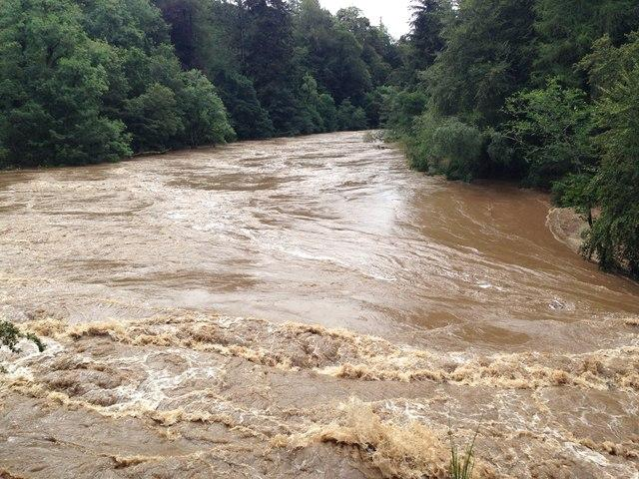
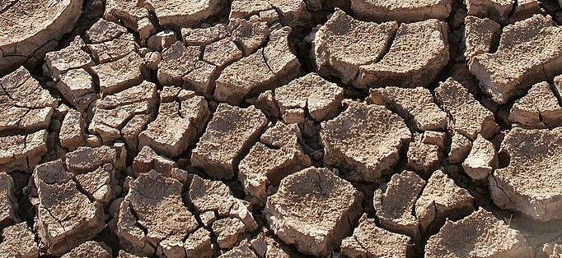
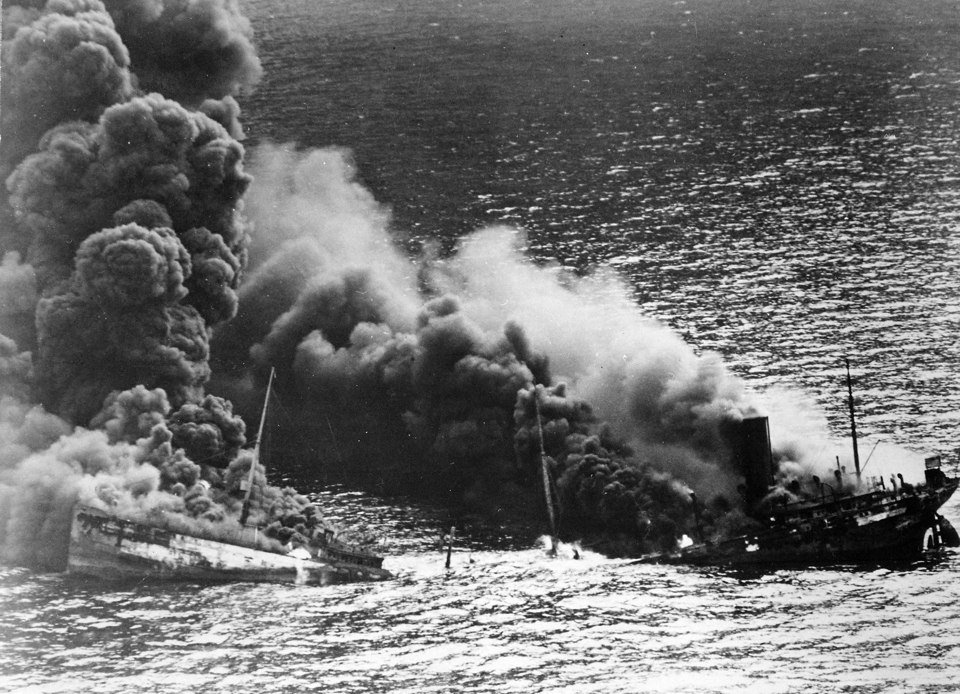

Conflict and Catastrophe
Ymbar, Kaustuv, David, Joe, Isaac, Catherine

Slide 23
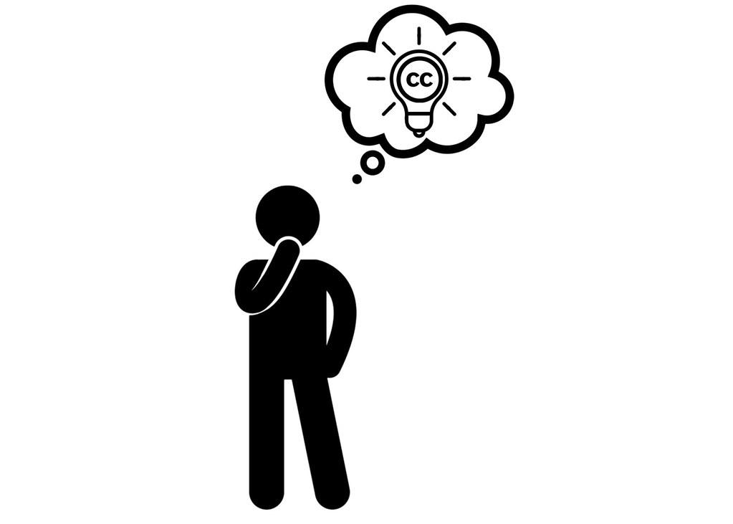
Numbers
We had many questions for GCAM about disaster…

Slide 24

Numbers
Narratives
and
We had many questions for GCAM about disaster…
Model is used to develop significant policies….

Slide 25

Numbers
Narratives
Numbers and Narratives
and
and
We had many questions for GCAM about disaster…
Model is used to develop significant policies….
What are the limits of a complicated model for complex systems?

Slide 26
To what extent can we capture concepts relating to conflict or catastrophe in GCAM?

Slide 27
Our world rapidly evolves…. does GCAM?
Static Assumptions
Neoliberal Econ

Slide 28

Our world rapidly evolves…. does GCAM?
Static Assumptions
Neoliberal Econ

Slide 29

Our world rapidly evolves…. does GCAM?
Static Assumptions
Neoliberal Econ

Slide 30

Our world rapidly evolves…. does GCAM?
Static Assumptions
Neoliberal Econ

Slide 31
Our world rapidly evolves…. does GCAM?
NOT WHAT GCAM WAS DESIGNED FOR
Static Assumptions
Neoliberal Econ

Slide 32
Conflict and Catastrophe Inputs to Track Outputs
Conflict and Catastrophe Analysis of Outputs
OR
Indicators of Water Insecurity
Extreme Droughts
Indicators of Food Insecurity
Long-term War
GCAM
Indicators of Energy Insecurity
Apocalypse Simulation
Elevated risk of instability
Civil Unrest
Conflict Indices

Slide 33
Conflict and Catastrophe Inputs to Track Outputs
Conflict and Catastrophe Analysis of Outputs
OR
Indicators of Water Insecurity
Extreme Droughts
Indicators of Food Insecurity
Long-term War
Question 1
GCAM
Indicators of Energy Insecurity
Apocalypse Simulation
Elevated risk of instability
Civil Unrest
Conflict Indices

Slide 34
Conflict and Catastrophe Inputs to Track Outputs
Conflict and Catastrophe Analysis of Outputs
OR
Indicators of Water Insecurity
Extreme Droughts
Indicators of Food Insecurity
Long-term War
Question 2
Question 1
GCAM
Indicators of Energy Insecurity
Apocalypse Simulation
Elevated risk of instability
Civil Unrest
Conflict Indices

Slide 35
Motivation and Framing
Numerous studies have explored the climate-conflict linkages
These pathways are complex: studies struggle to come up with a set list or linear relationship
For example, U-curve of water scarcity and cooperation
However, these relationships can be used to assess ‘risk’ of instability or conflict, acknowledging that they are not perfect predictors
GCAM offers similar FEW- related outputs to many of these indicators
Can we combine methods to map FEW-scarcity indicators onto a GCAM ensemble to assess where and when conflict risk in specific regions may occur?
What does this mean in the context of GCAM? How realistic are these results?
Are these useful? -> outputs highly dependent on inputs

Slide 36



Motivation and Framing
Can we combine methods to map FEW-scarcity indicators onto a GCAM ensemble to assess where and when conflict risk in specific regions may occur?
What does this mean in the context of GCAM? How realistic are these results?
Are these useful? It is a good index?

Slide 37
Table
Indicator | Pardee-RAND FEW Insecurity Index | GCAM | Sub-indicator
1 | Domestic Food Price Level Index | Price staple foods/GDP per capita | Food
2 | Share of Dietary Supply from Non-starchy Foods | Supply non-staple to staple | Food
3 | Supply of daily dietary calories Relative to Minimum Dietary Requirement | Supply to some baseline per person | Food
4 | log of per capita electricity to the log of the per capita electricity consumption required to meet basic needs | Per capita electricity consumption/4000 | Energy
5 | Geometric mean of percentage of population with access to electricity | Price electricity/GDP | Energy
6 | percentage of population using modern fuels for cooking and heating. | Traditional Biomass/total energy | Energy
7 | total water withdrawals for municipal uses with the country-wide water requirements | Water Consumption/Min Daily Requirement | Water
– | proportion of the population that uses an improved source of drinking water and the proportion of the population using improved sanitation facilities. | Not applicable | –
8 | total per capita internally available renewable water. | Groundwater vs run-off | Water
Slide Title Subhead
Willis, Henry H., David G. Groves, Jeanne S. Ringel, Zhimin Mao, Shira Efron, Michele Abbott, Zohan Hasan Tariq, and Michael W. Robbins, Interactive Pardee RAND Food-Energy-Water Security Index. Santa Monica, CA: RAND Corporation, 2024. https://www.rand.org/pubs/tools/TLA2942-1.html.

Slide 38
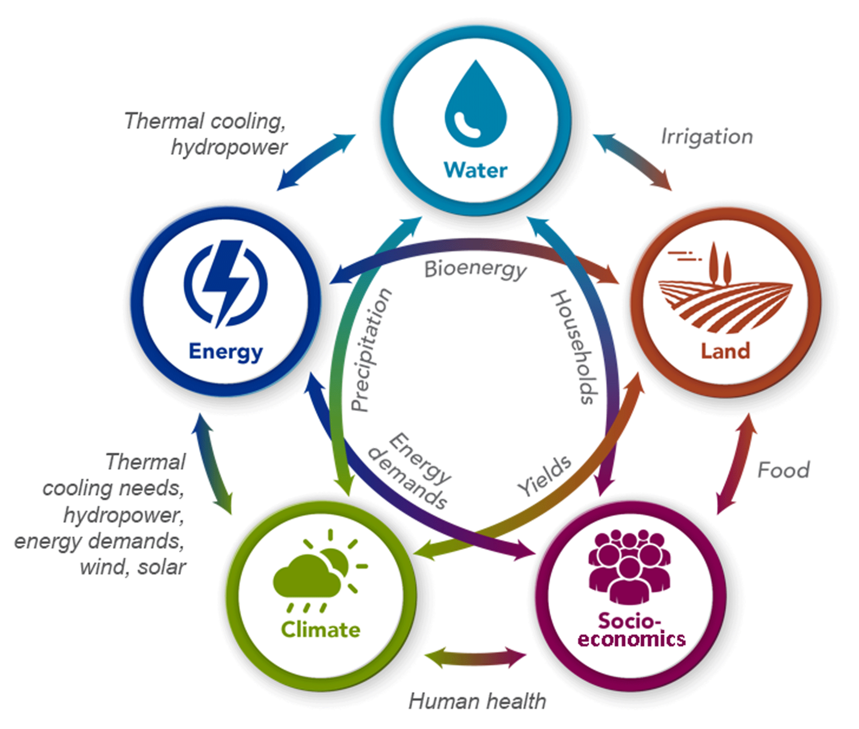
But…these indicators are highly dependent on inputs
GDP
Population
Demand Elasticities
Calvin, et al. (2019)
Notes:
alvin, K., Patel, P., Clarke, L., Asrar, G., Bond-Lamberty, B., Cui, R. Y., Di Vittorio, A., Dorheim, K., Edmonds, J., Hartin, C., Hejazi, M., Horowitz, R., Iyer, G., Kyle, P., Kim, S., Link, R., McJeon, H., Smith, S. J., Snyder, A., Waldhoff, S., and Wise, M.: GCAM v5.1: representing the linkages between energy, water, land, climate, and economic systems, Geosci. Model Dev., 12, 677–698, https://doi.org/10.5194/gmd-12-677-2019, 2019.

Slide 39
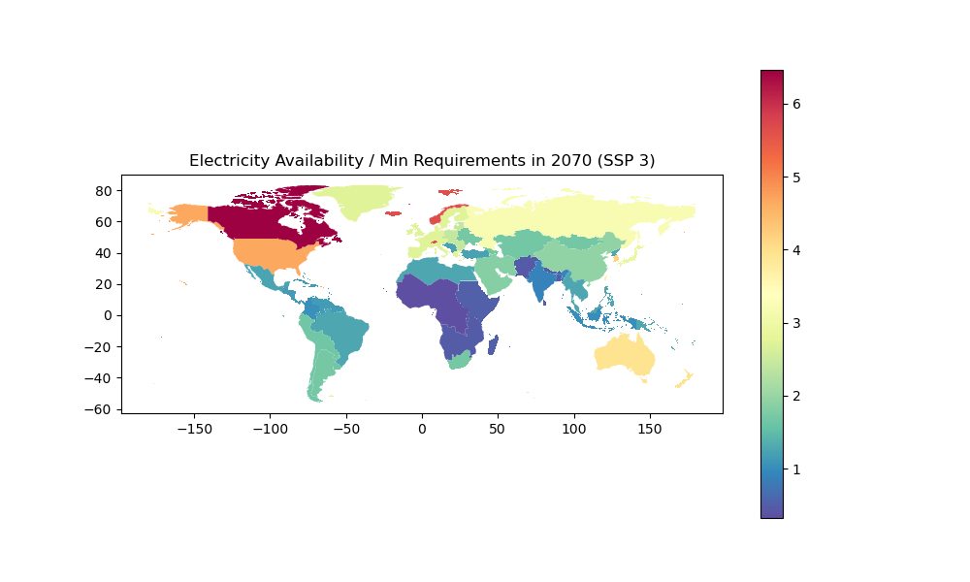
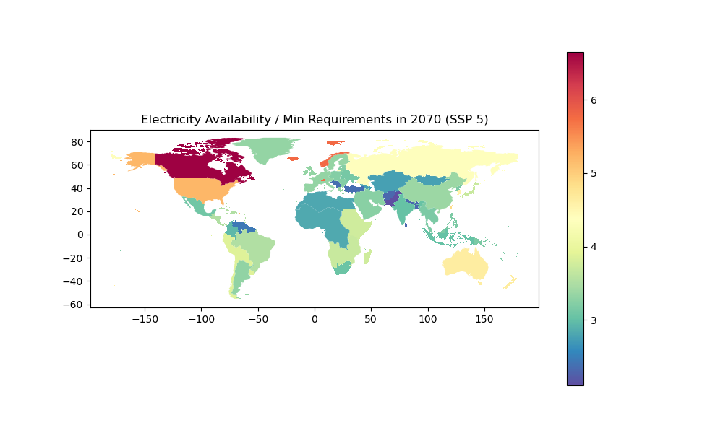
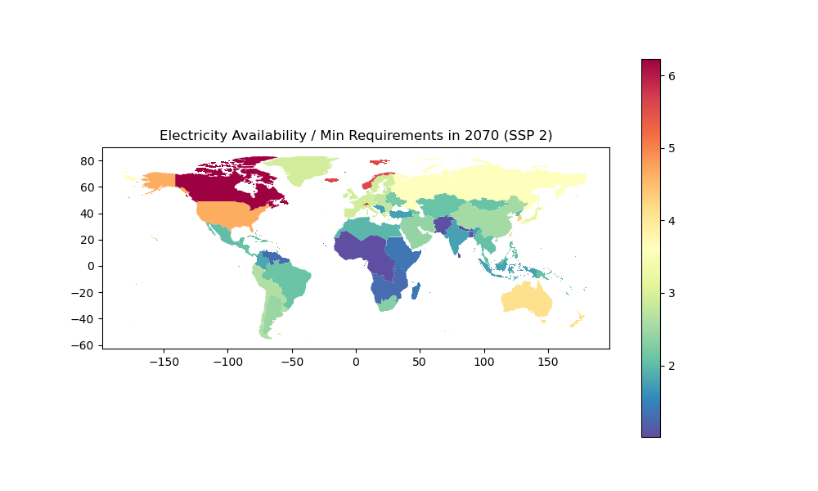
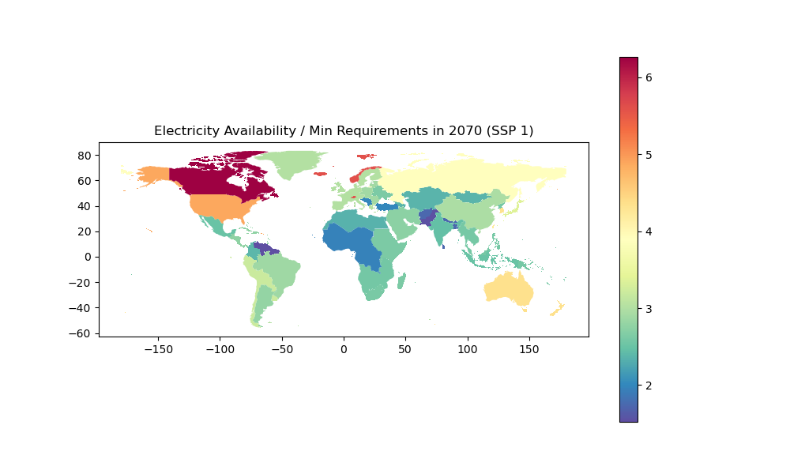
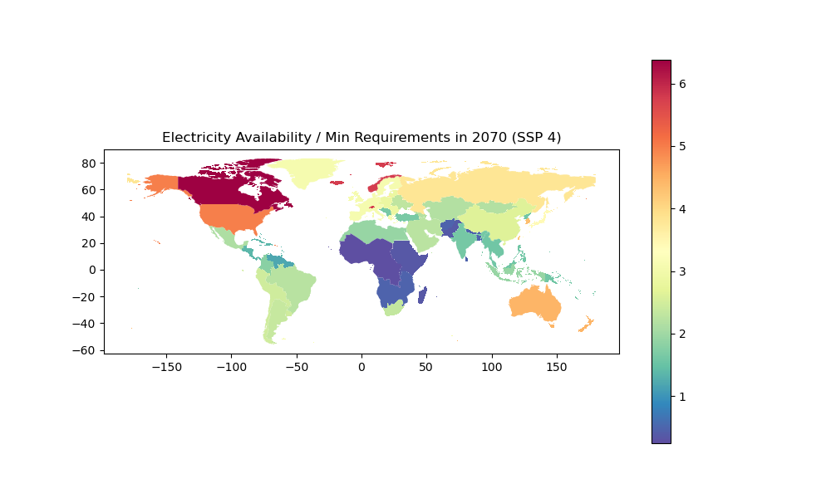
Step 1: Track individual indicators across scenarios

Slide 40
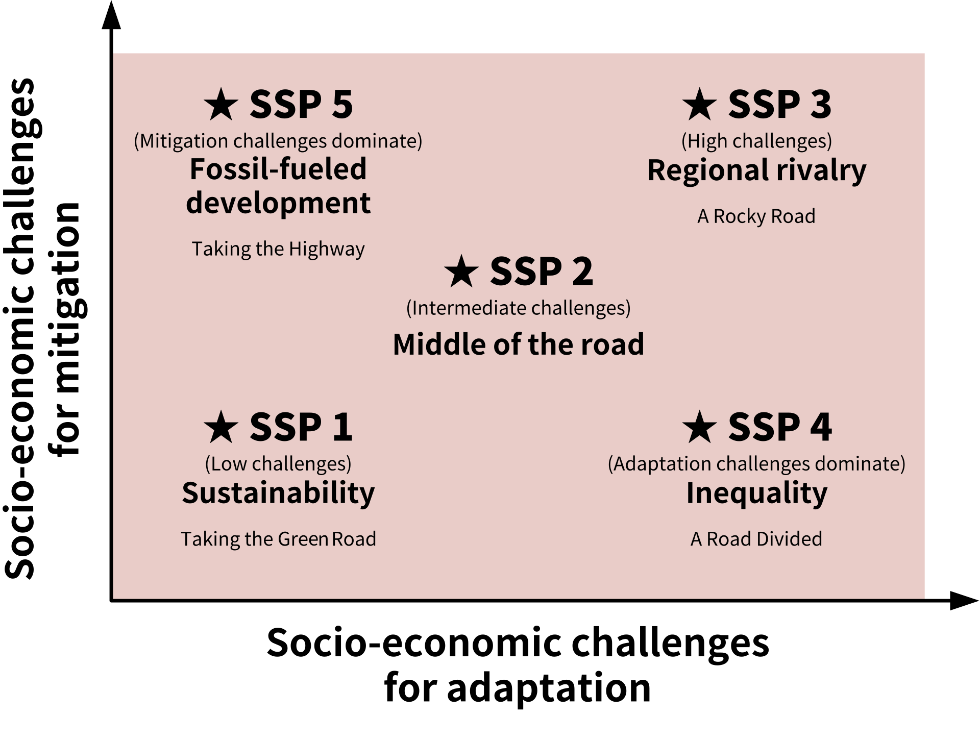

Slide 41
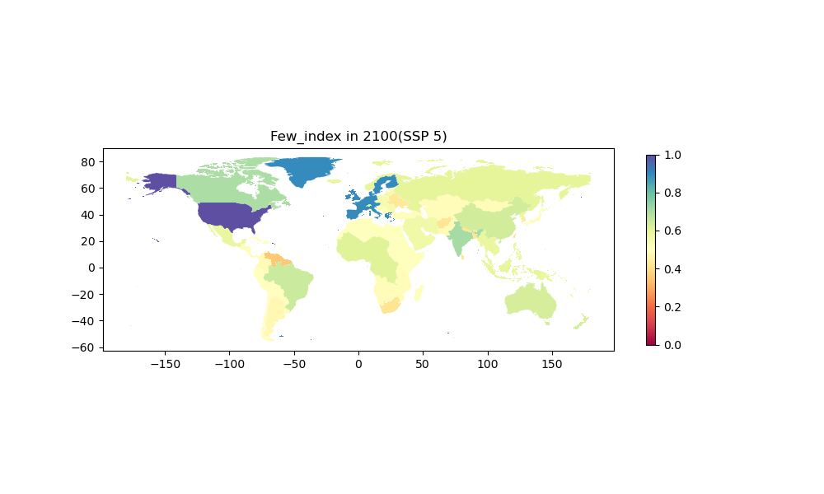
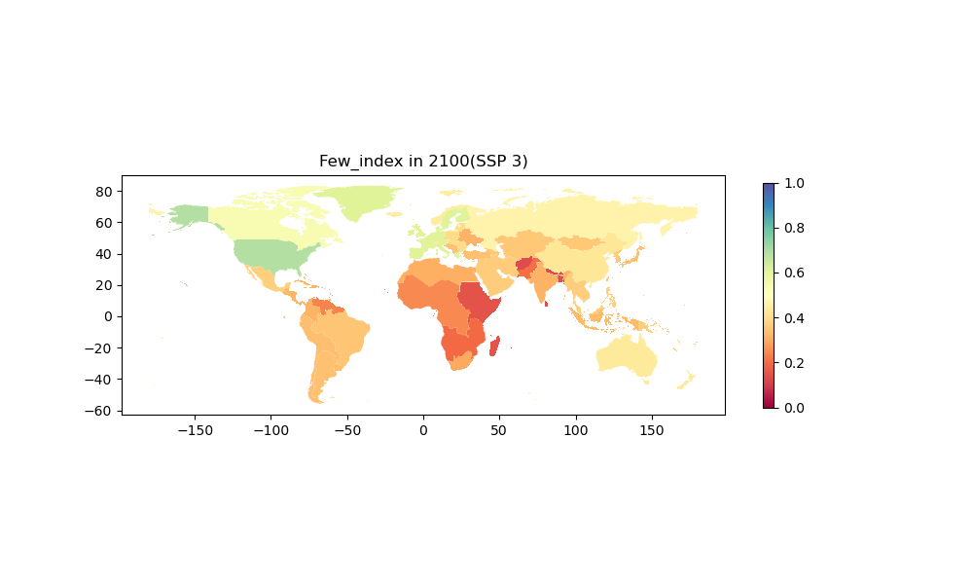
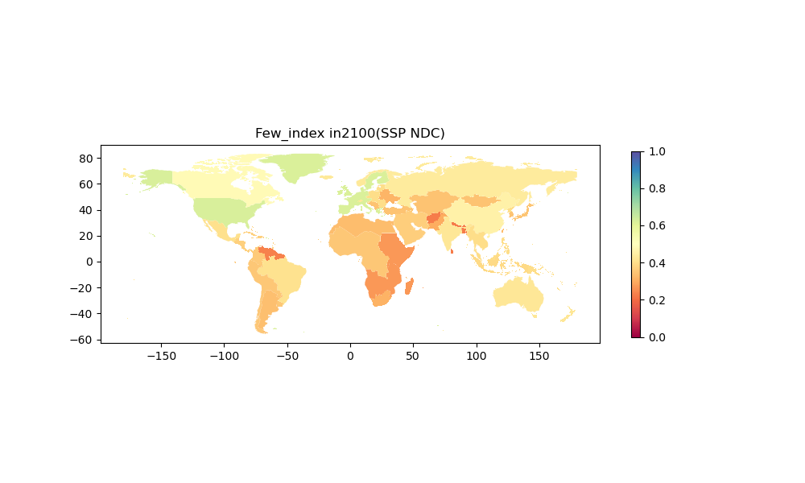
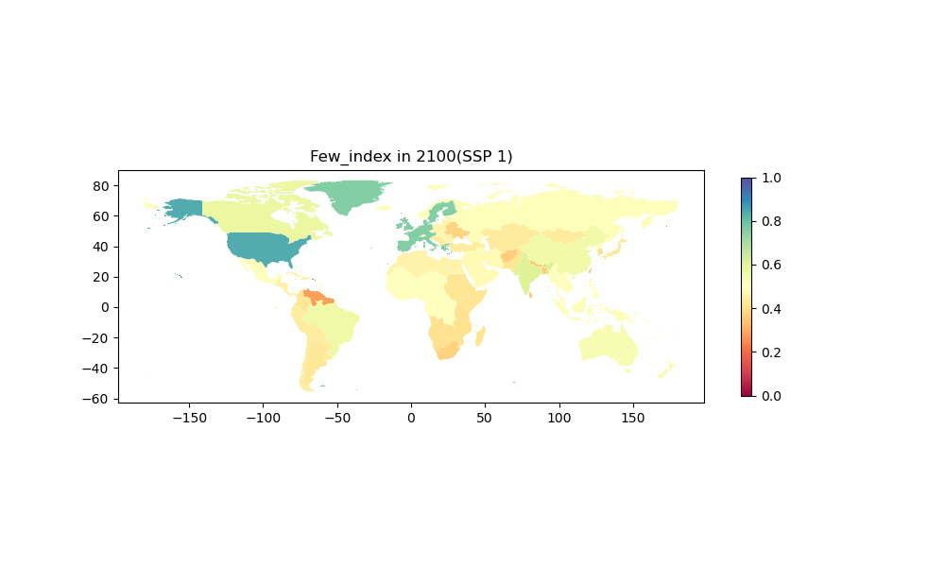
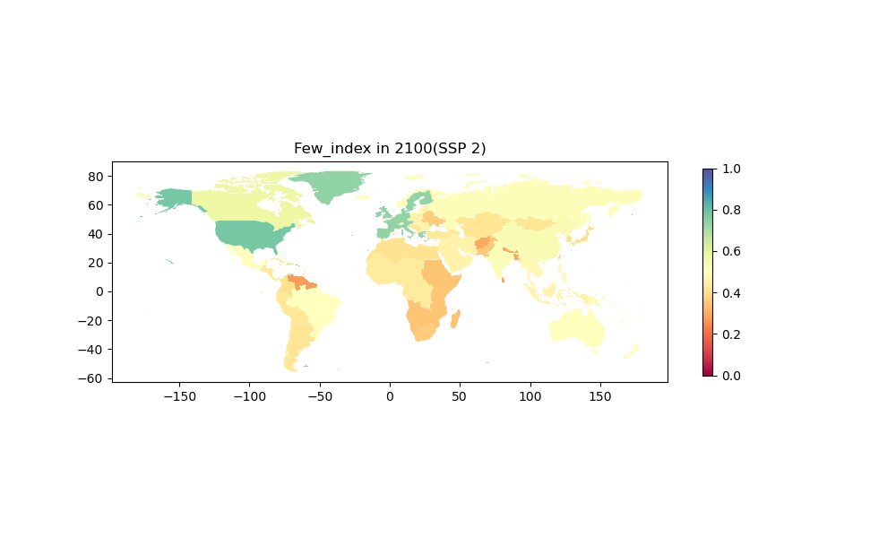
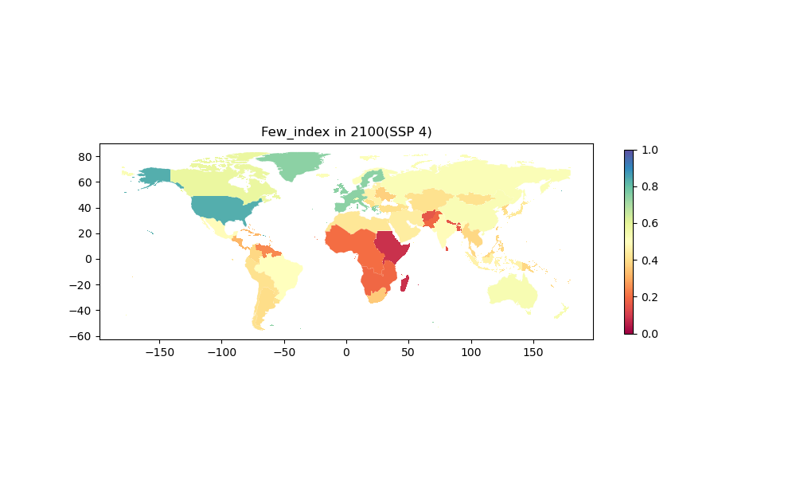
FEW Index at 2100 Across Scenarios - We get results that make sense!

Slide 42

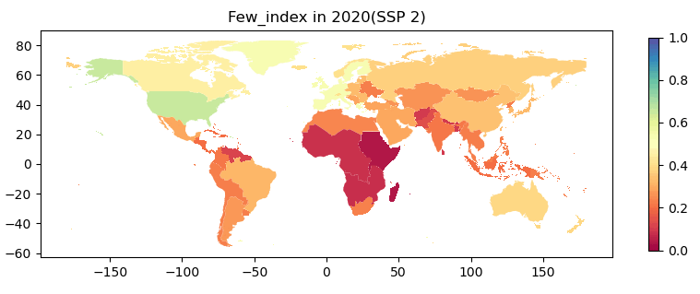
Step 3: Track FEW Index Changes Over Time (SSP 2)

Slide 43

Track FEW Index Changes Over Time (SSP 4)

Slide 44


Now that we proved the concept, what happens if we change the scenario to the same mitigation scenario as the previous group?
SSP2: Middle of the Road
Reduced Carbon Emissions

Slide 45
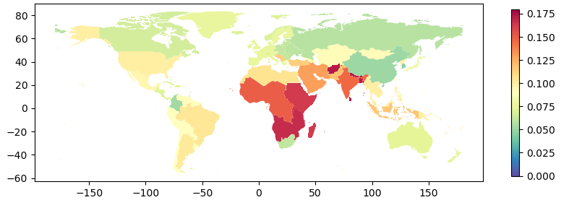
% Worsening of FEW Index with Mitigation - Tradeoffs
Worse Index
No Change
Better Index

Slide 46
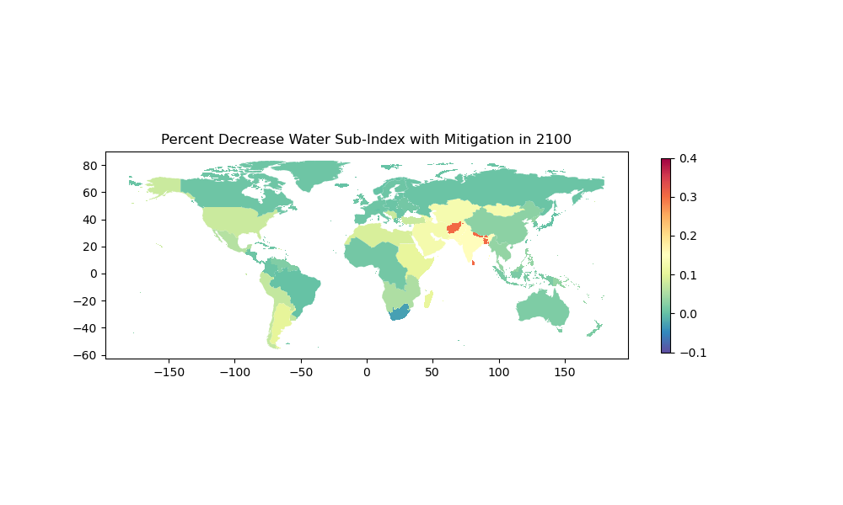
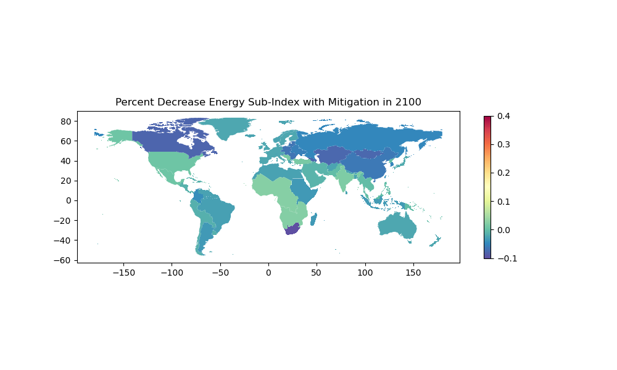
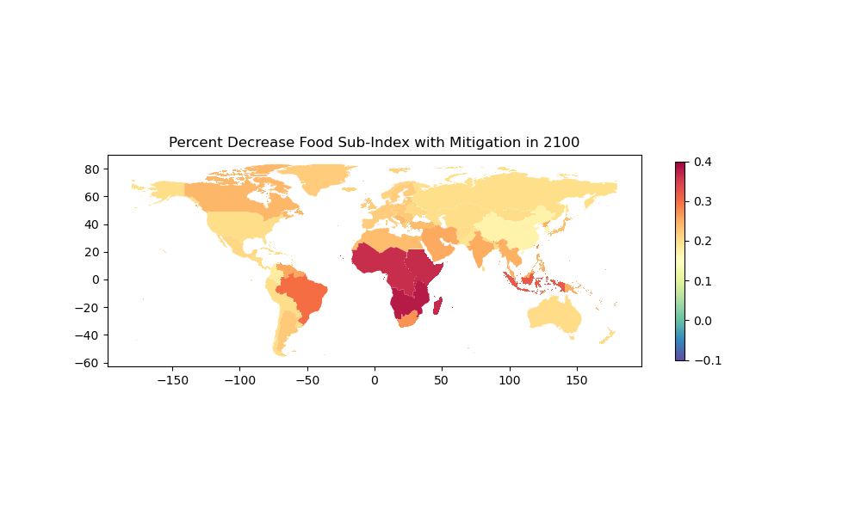
Worse Index
No Change
Better Index

Slide 47
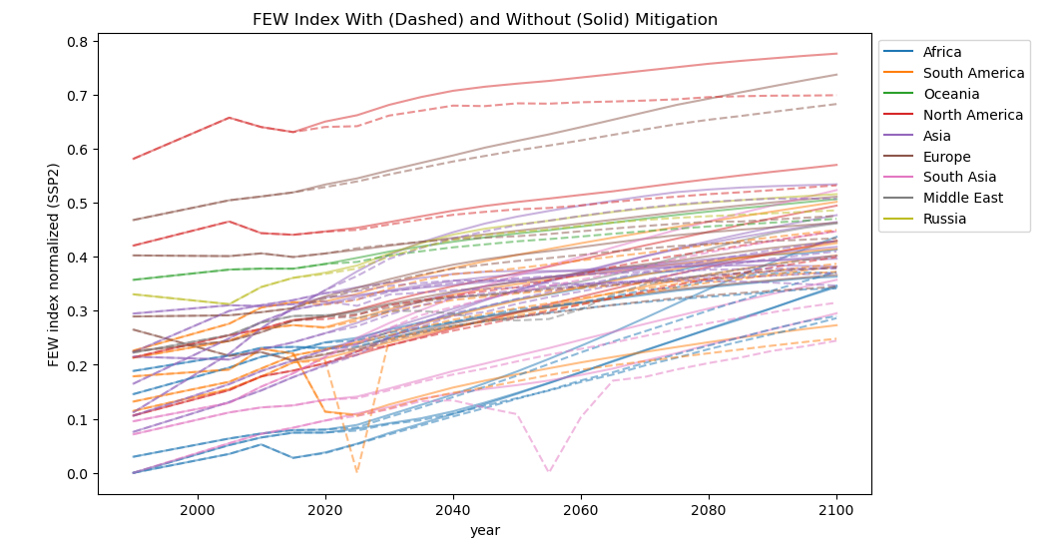
Index illustrates increased risk of FEW-related conflict, particularly in Global South

Slide 48


Conclusions of the FEW-Index Experiment
Captured Pardee-RAND FEW Index
Tested index across scenarios
Demonstrated use in policy comparisons
Accuracy and meaning
Benefit (?) of singular indicator
Impact of local context and institutions on mitigating conflict risk

Slide 49
Can we cause short-term catastrophe’s in GCAM?

Slide 50
Motivation and Framing
As an equilibrium model, GCAM is primarily designed to analyse long-term impacts on global systems.
This project aims to explore if short-term catastrophic climatic shocks can be modelled using GCAM.
We modelled a decade-long severe heatwave in the American midwest by decreasing runoff in the Arkansas, Missouri, and South Mississippi river basins by 70%
To what extent can a climate shock (drought) affect agriculture production, and prices in the US and beyond?

Slide 51
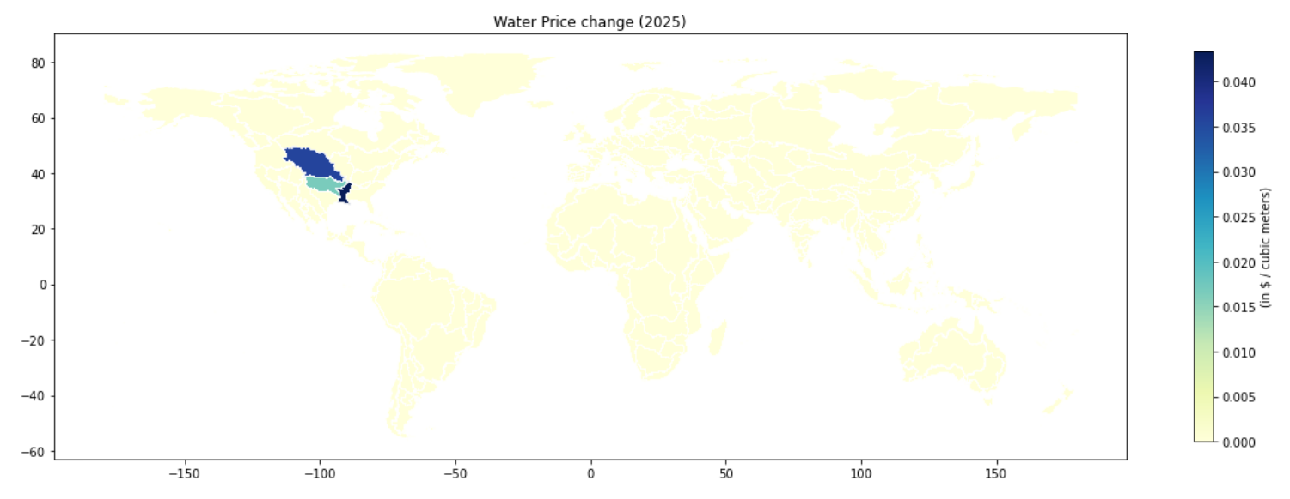
Notes:
Water prices increase in Missouri, Arkansas, and Southern Mississippi basins. Rest of the world do not see any major changes.
Does that mean water prices are localized?

Slide 52
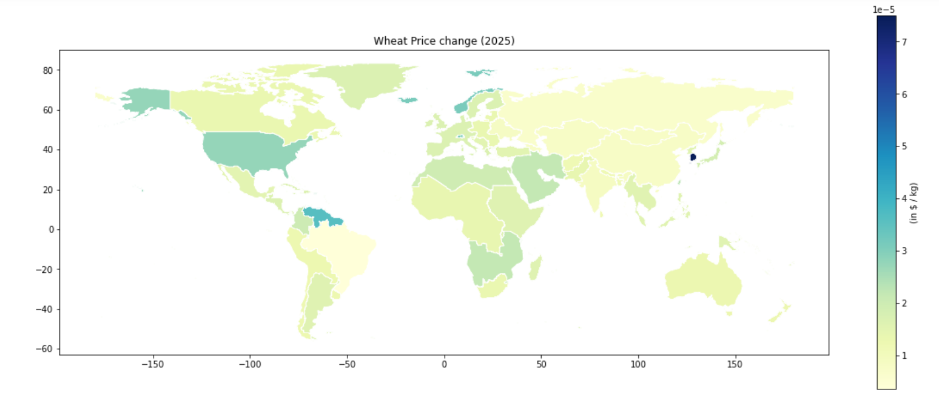
Notes:
Wheat prices increase significantly in USA, Norway, Korea, and Northern regions of South America (maybe Sensitive markets?). Slight increase in the middle-east, north Africa, and east Asia.
Changes in production in one part of the world can have ripple effects across regions due to trade linkages, especially on markets sensitive to supply disruptions.

Slide 53
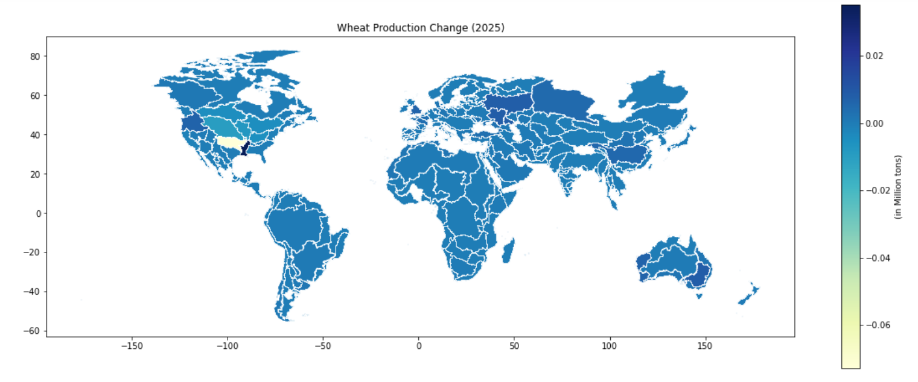
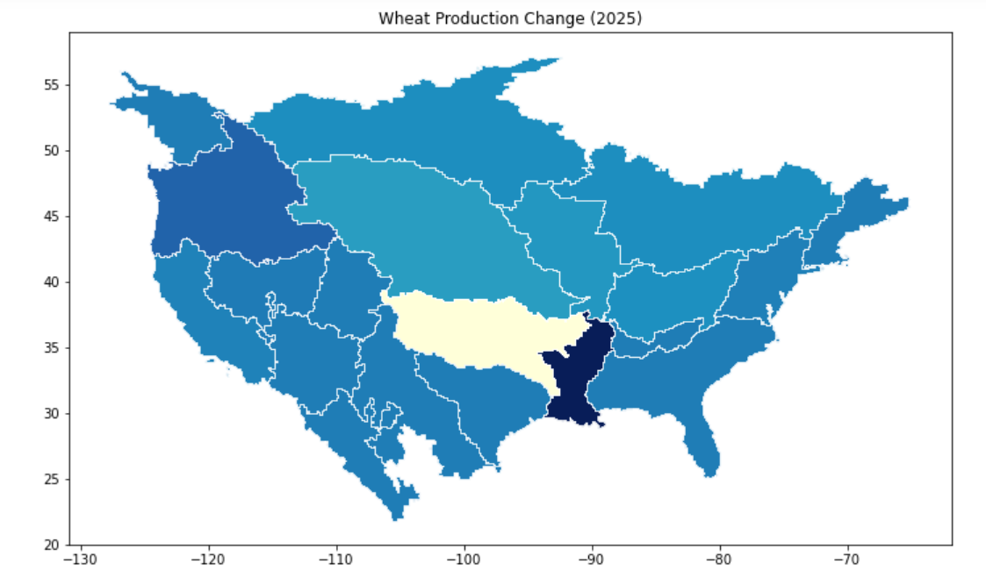
Notes:
Wheat production significantly decreases in Arkansas river basin (maybe relies heavily on irrigation?) but increases in Mississippi south (might have alternative water sources or more resilient agricultural practices? )

Slide 54

Conclusion
GCAM can incorporate behavioral responses and adaptation strategies to some extent

Slide 55
Conclusion
GCAM can incorporate behavioral responses and adaptation strategies to some extent
2. It is limited by its underlying assumptions and modeling framework

Slide 56
Conclusion
GCAM can incorporate behavioral responses and adaptation strategies to some extent
2. It is limited by its underlying assumptions and modeling framework
3. Since it is an equilibrium model, it adapts to these catastrophic shocks by reallocating wheat production across nations and regions, but may not always be practically feasible because of difference in geography, climatic, political, cultural and economic factors.

Slide 57

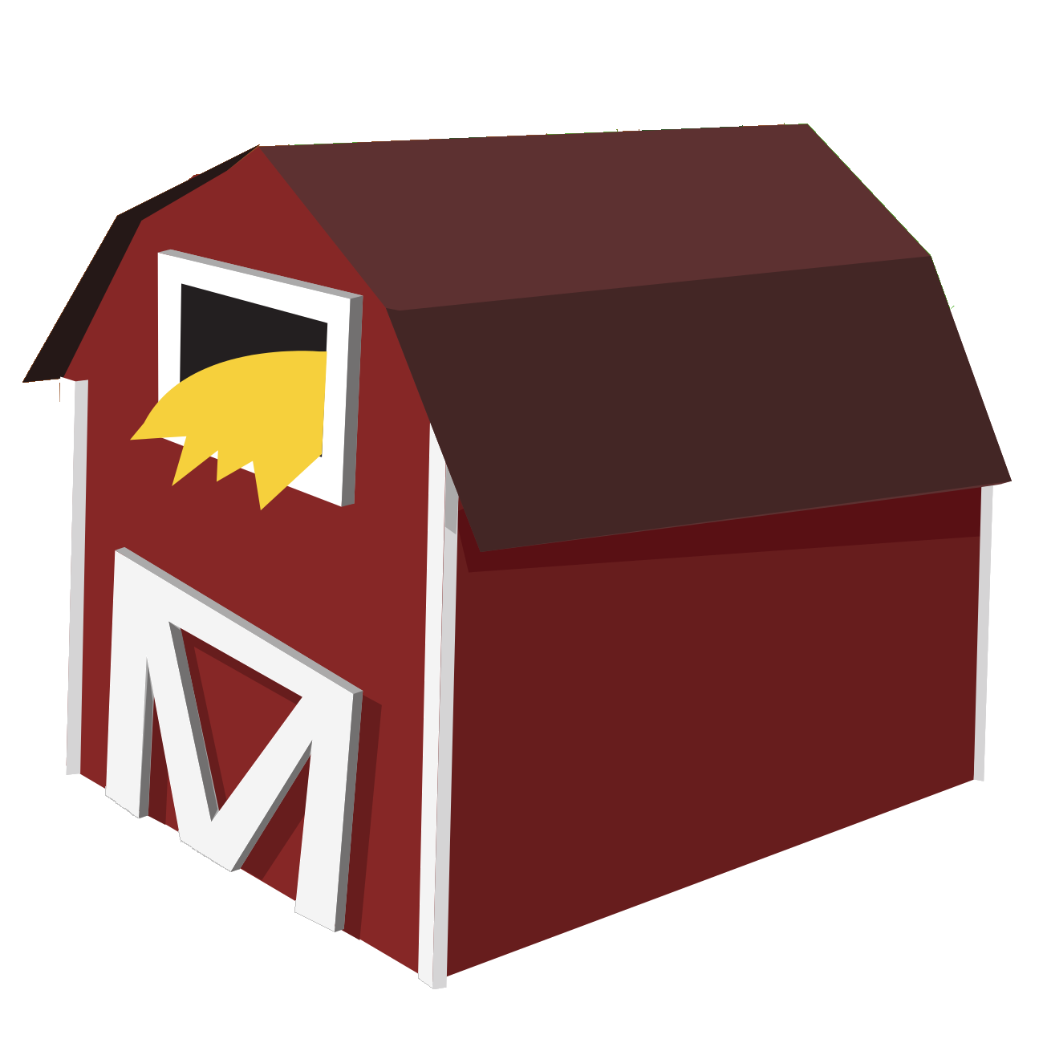
Conflict as Reduced Land Availability
During conflict, production shifts (increase in weaponry, decrease in other things)
Of particular interest within GCAM, large scale conflict takes farmland out of production

Slide 58
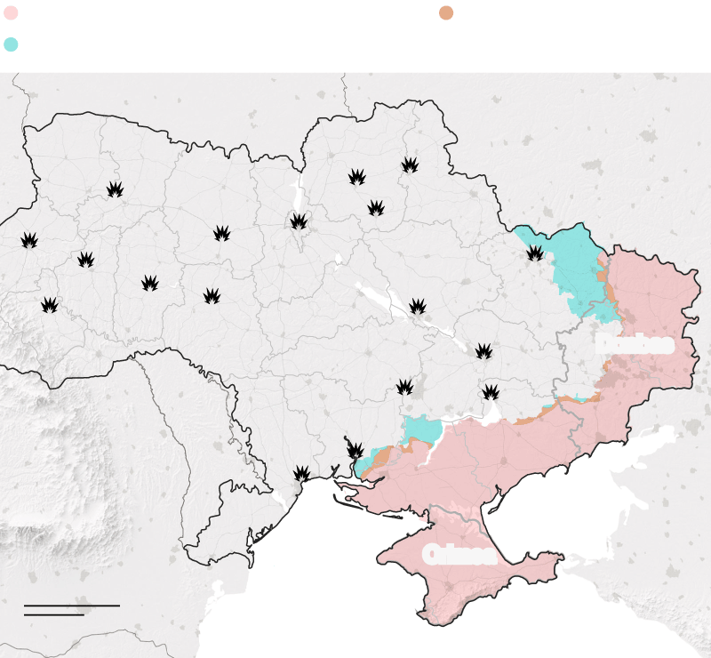

Slide 59

Conflict as Reduced Land Availability
During conflict, production shifts (increase in weaponry, decrease in other things)
Of particular interest within GCAM, large scale conflict takes farmland out of production
We tried to take farmland out of production but saw no effect on outputs
Why?

Slide 60
Conflict + Catastrophe Group Conclusion
GCAM, when used properly, can be a powerful tool
Challenges of using GCAM - nature of equilibrium models
GCAM can begin to illustrate how climate mitigation policies could increase regional risk of instability or unrest
GCAM cannot be used to predict conflict

Slide 61
We focused on pushing the model beyond its use to a point of failure. We searched for implications of model rather than model itself.
No such thing as prediction within complex systems- we learned when these models can be a powerful tool and when they are not.
We investigated multiple ways that IAMs can be integrated with narratives around conflict and catastrophe.
Notes:
productive failures

Slide 62
How should we approach and use GCAM, given the complexities of the systems it represents?

Slide 63
Exploring GCAM's Capabilities and Limitations
GCAM's Equilibrium Focus:
Designed for analyzing long-term environmental, economic, and energy trends.
Limited in addressing rapid changes or shocks like sudden climate events or economic crises.
Implications for Policy:
Crisis Management: May not capture immediate impacts of sudden events, presenting challenges in crisis response planning.
Policy Adaptation: Essential for policymakers to understand these limitations
Notes:
it is all great content to say- just overwhelming on a single slide!

Slide 64
Exploring GCAM's Capabilities and Limitations
Communicating with Policymakers:
Clear Communication: Simplify complex model outcomes into actionable insights that can be readily used in decision-making processes.
Relevance to Policy: Tailor communication to highlight how GCAM’s projections align with or inform specific policy goals, especially in areas like long-term climate strategy and energy planning.
Engagement Strategies: Facilitate workshops and briefings that allow policymakers to interact directly with model outputs, enhancing their understanding and ability to utilize the information effectively.

Slide 65



Exploring GCAM's Capabilities and Limitations: Policymaking
Clear Communication: Simplify complex model outcomes into actionable insights
2. Relevance to Policy: Tailor communication to highlight how GCAM’s projections align with or inform specific policy goals
3. Engagement strategies: Facilitate workshops and briefings that allow policymakers to interact directly with model outputs

Slide 66
Enhancing IAM Engagement and Communication
Objective: Broaden stakeholder involvement across all climate models
Strategies: Conduct more inclusive community consultations, integrate diverse local and indigenous knowledge, actively include marginalized communities.
Challenges: Communicating complex results from climate models to non-expert audiences.
Solutions: Employ simplified narratives, utilize visual tools, and engage through interactive platforms to enhance understanding and drive actionable insights.
Stakeholder Engagement
Science Communication

Slide 67
PFI 1 Takeaways: Numbers and Narratives in the Context of IAMS
GCAM works in a very narrow way (some parameters are local without interconnections) -> missing work for inferences later
Some of the other factors are so interconnected that we get impractical results -> ie wheat production being completely mobile (practically infeasible due to contexts in other places)
Issue of model accessibility -> if we don’t know how the model works, we need to be very careful about using them for policy development -> in some cases, the best we can do is to use them as a discussion tool
Our assumptions in modelers (narratives) affect model outcomes (numbers) -> this is an all modeling problem
GCAM is not predictive- this is a very different kind of model due to lack of hypotheticals
role of uncomfortability -> nothing is just going to work, we need to work around it

Slide 68

PFI 3: Numbers and Narratives in IAMs
Models must be accessible for equitable policy development.

Slide 69
PFI 3: Numbers and Narratives in IAMs
Models must be accessible for equitable policy development.
The scales at which we run our models is an important decision. Global models should be used in conjunction with local models.

Slide 70
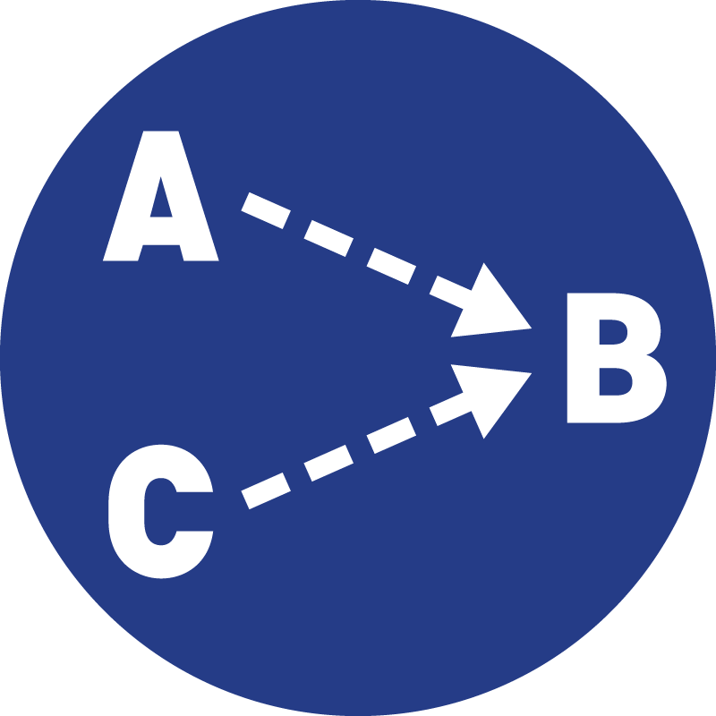
PFI 3: Numbers and Narratives in IAMs
It is important to use and frame these models as ‘potential futures,’ rather than communicating about them as predictive.
Models must be accessible for equitable policy development.
The scales at which we run our models is an important decision. Global models should be used in conjunction with local models.

Slide 71

PFI 3: Numbers and Narratives in IAMs
It is important to use and frame these models as ‘potential futures,’ rather than communicating about them as predictive.
Models must be accessible for equitable policy development.
The scales at which we run our models is an important decision. Global models should be used in conjunction with local models.
Assumptions drive outputs (numbers) which feeds our narratives. Our narratives then drive what assumptions we make in a cyclical pattern.

Slide 72
The Dark Arts of Data Science
PFI 2023-2024

Slide 73
Starting Goals
Practical Wisdom
Become conscientious data scientists
How data science works
How it persuades
Connecting numbers to narratives
How it can be abused

Slide 74
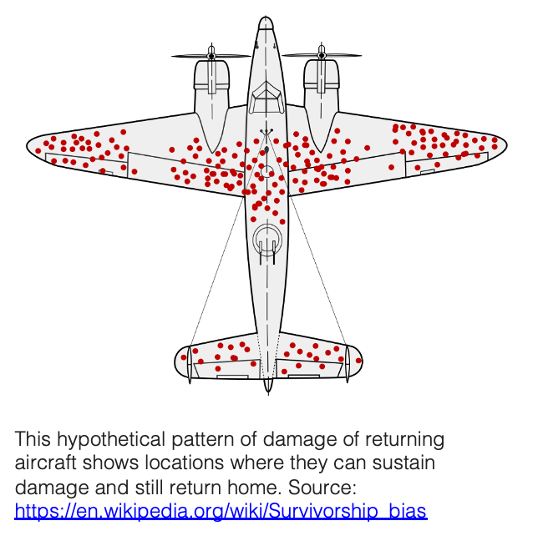
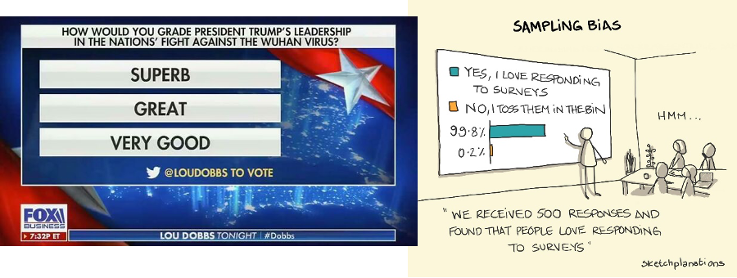
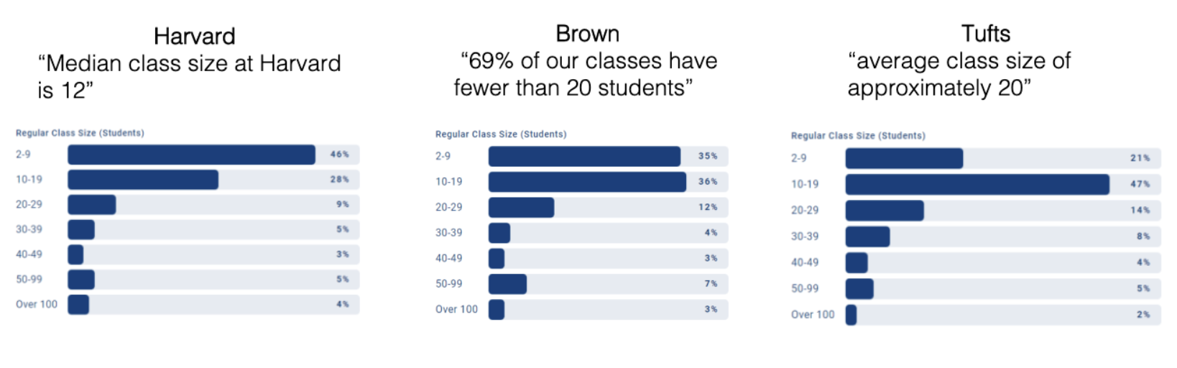
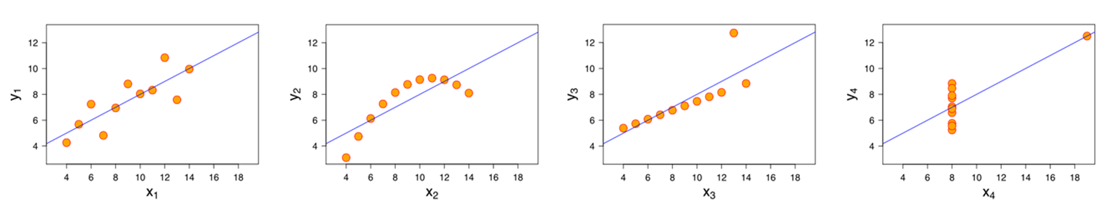
How can Data and Statistics Mislead?
Formal Knowledge
Notes:
Class Sizes: Most universities report class sizes based on measures of central tendency. This is very important for national rankings, so having a lower number is better. However, as we can see these measures don’t really give us a great picture of the whole story. This is further exemplified by the Columbia University scandal which happened in 2022 where a faculty member had separately analyzed data and found inconsistencies with the reported data.
Ascombe’s Quartet: These four data sets plotted have the identical simple descriptive statistics, but have very different distributions. Further shows how raw data can be better at describing the whole narrative of the data.

Slide 75
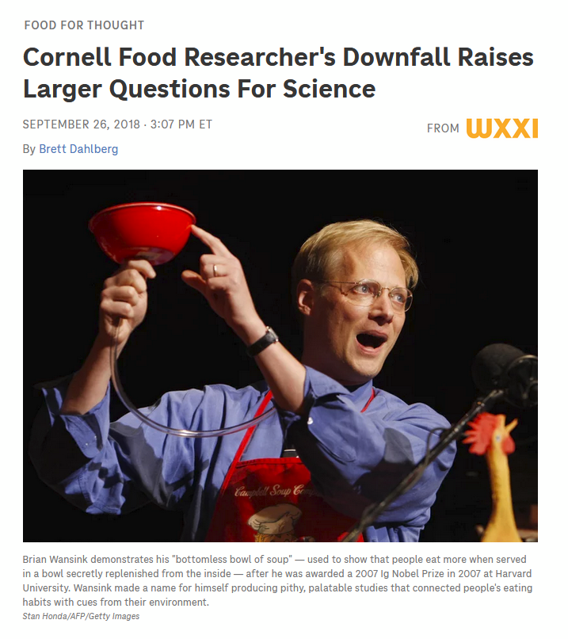
How can Data and Statistics Mislead?
Formal Knowledge
Scientific fraud
p-Hacking
HARKing
Multiple Comparisons
Tests
GRIM
Benford’s Law
Notes:
GRIM: A simple statistical test used to identify inconsistencies in the analysis of data sets. Given a dataset containing N integer values, the arithmetic mean (commonly called simply the average) is restricted to a few possible values…
Benford’s Law: Is an observation that in many real-life sets of numerical data, the leading digit is likely to be small

Slide 76
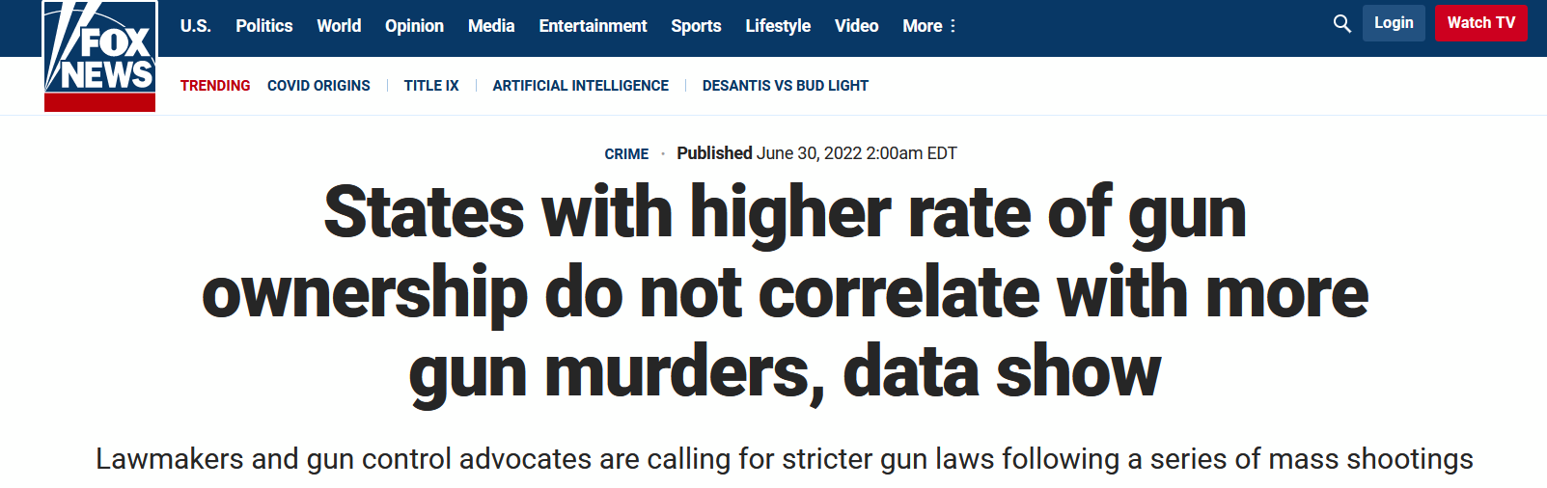
Can We Replicate this Fox Article Analysis?
Practiced Techniques

Slide 77


Can We Replicate this Fox Article Analysis?
Practiced Techniques

Slide 78
Can We Replicate this Fox Article Analysis?
Practiced Techniques
Reasonable Sources
FBI
# Murders
# Murders by Firearm
Census Bureau
Population by state
RAND Corporation
Estimated percentage of homes with a gun
Imperfect Visual
Bars are on the same axis
Slight discrepancy in values
Not systematic in a particular direction
Does not change overall pattern
Years of data not consistent
2016 ownership estimates
2019 murder and population statistics
Missing Data
Alabama, Florida, Illinois excluded
Incomplete reporting to the FBI
Bar chart
Not optimized for correlation analysis

Slide 79

Can We Replicate this Fox Article Analysis?
Practiced Techniques

Slide 80

Can We Replicate this Fox Article Analysis?
Thoughtful Practice
Correlation Coefficient: 0.14
There does not appear to be a relationship between the proportion of homes with a gun and the number of gun murders per 100,000 people
Fox’s method was reasonable and consistent with the headline
BUT the article did not stop at this measured, data-supported claim

Slide 81
Informal Logic and Fallacies
Thoughtful Practice
Formal
There is a pattern of reasoning rendered invalid by a flaw in its logical structure that can neatly be expressed in a standard logic system.
E.g.
All humans are mammals.
Fido is a mammal.
Therefore, Fido is a human.
Informal
The source of the error is also due to the content and context of the argument. Often connected to ambiguous expressions and implicit premises
E.g.
Feathers are light. ("light" = "not heavy")
Light cannot be dark. (“light” = “color”)
Therefore, feathers cannot be dark.

Slide 82
Building a Corpus for Experimentation
Hypothesis: The mainstream news conducts reasonable data analysis, but there are logical leaps and fallacies in their use of those analyses to create narratives.

Slide 83

Building a Corpus for Experimentation
Scrape articles from major outlets
Media Cloud
Hand code disconnects
Focus on covid case study
Notes:
Fox News
CNN
CBS
NBC
ABC
MSNBC
NPR
The New York Times
Washington Post

Slide 84
Future Work
Extend to a variety of topics
Comparative analysis
Expand time and source scope
Develop new methods of computational analysis

Slide 85
Key Takeaways
Learning to learn
Not every idea is a winner
Iterative research
Finding a common language across disciplines
Challenging, but rewarding

Slide 86
PFI_Presentation_2024.pptx

